Slide 1

Novel Architecture of Integrated Photovoltaic (PV) and
Energy Storage
Al-Quds University
Florida Power Electronics Center
University of Central Florida
March 3, 2018

Slide 2
Outline
Market Outlook
Current Challenging Issues
Our Solution: The iPV⁺⁺ System
iPV⁺⁺ Features
Future Smart-Grid
Summary

Slide 3







University of Central Florida
    * 67,000 students
  * $145M+ in Research Funding
* Research Park

Slide 4
Florida Power Electronics Center (FPEC)
Team Members
Dr. Issa Batarseh: Director and Professor of Electrical Engineering, ECE
Ph. D.: Students:
Mahmood Ali Alharbi
Xi Chen
Gustavo Gamboa
Abdullah Al-Haltani
Fahad Al-Haq
Khalil Alluhaybi
Anirudh Ashok Pise
Amit Bhattacharjee
Associated Researchers and Collaborators:
Dr. Seyed Milad Tayebi, Post-Doc
Dr. Haibing Hu, Visiting Scholar, China
Dr. Nasser Kutkut, Associate Researcher
Dr. Paul Brooker, FSEC
Dr. Osama Abdel-Rahman
Dr. Said Al-Halaj, AllCell Technologies
Dr. Ahmad Harb, Jordan
Dr. Khalid Rustom, ACT
Dr. John Elmes, APECOR
M.S Students:
Houman Pousti

Slide 5
The Florida Power Electronics Center (FloridaPEC)
Our Team has successfully demonstrated the following technologies/prototypes/products:
Two spin-off companies: Petra Systems and APECOR.
Developed and commercialized the first micro-inverter from academia.
Designed and prototyped three-port converter with soft switching and high efficiency intended for space applications.
Developed the first three-phase micro-inverter with efficiency, cost and power density targets set by DOE.
Developed the highest power density 1/16 brick DC-DC converters.
New patented Phase Change Composites (PCC) packaging techniques developed by AllCell and ready for the proposed package and integration.
APECOR has developed and commercialized highly efficient and smart chargers for military applications.

Slide 6
Testing Facilities: The Florida Solar Energy Center (FSEC)
A test deployment and test bed will be implemented at the Florida Solar Energy Center (FSEC).
FSEC is the largest and most active state supported renewable energy and energy efficiency research, training and certification institute in the US.
FSEC is recognized by DOE and IEC as meeting the requirements of a private-sector NRTL.
FSEC has long worked with standards and certification groups, and is the “hot-humid” Regional Test Center of DOE’s PV Bankability project.
Using FSEC’s expertise in building energy profiles, control profiles will be applied to our system to simulate PV firming, peak shaving and other grid services.

Slide 7
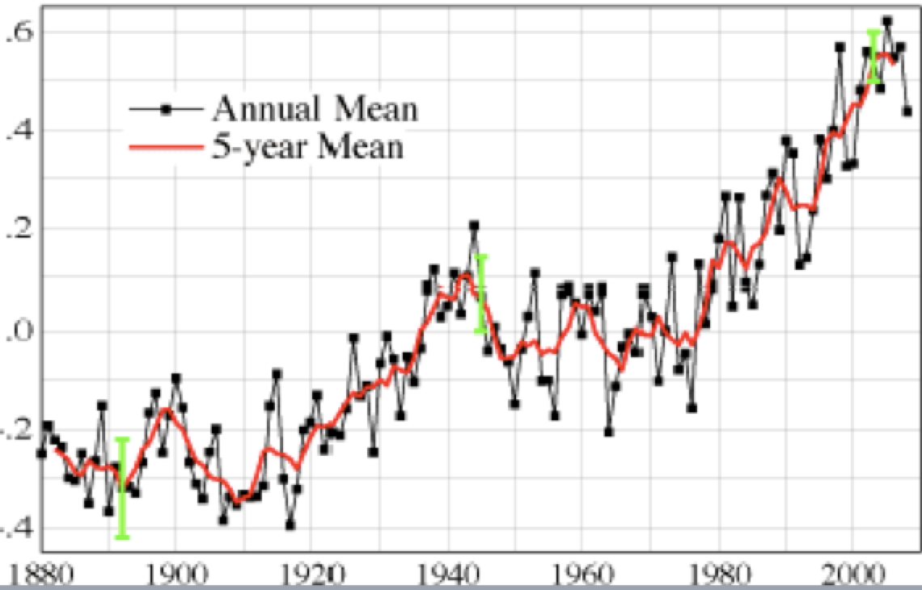
Global Land-Ocean Tem.
(ºC)

Slide 8
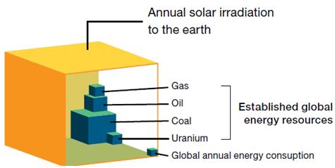
Solar is the Answer … Looking up !
Inexhaustible
Near Zero impact on environment
The technology is ready
Proven economic feasibility.
Highly flexible
No water
Foreseen improvements in grid integration
Easy to integrate with batteries
Earth’s Energy Resources
Notes:
http://www.dailymail.co.uk/news/article-2055520/Feed-tariffs-Entire-area-Nottingham-gets-solar-panels-fitted-roofs.html
http://www.treehugger.com/solar-technology/powering-20000-homes-the-worlds-largest-pv-solar-farm-opens.html
http://www.motherjones.com/blue-marble/2015/07/obama-just-made-it-easier-low-income-communities-go-solar

Slide 9
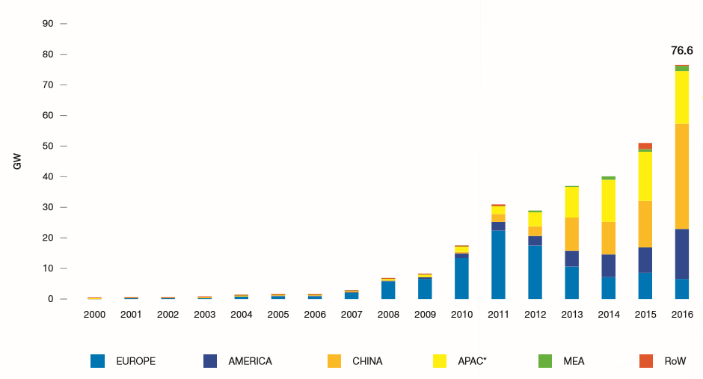
Evolution of Global Annual Solar PV Installed Capacity 2000-2016
PV is less than 1% world market share of electricity capacity
PV among fastest growing segments: enormous upside
  23% 20-year CAGR
  44% 5-year CAGR
  47% in 2017
Energy trends support solar and battery integration
  High PV penetration in certain markets and regions
  Introduction of State Regulatory
  PV alone is now lower than grid parity.
Selected from Global Market Outlook for Solar Power/2017-2021

Slide 10
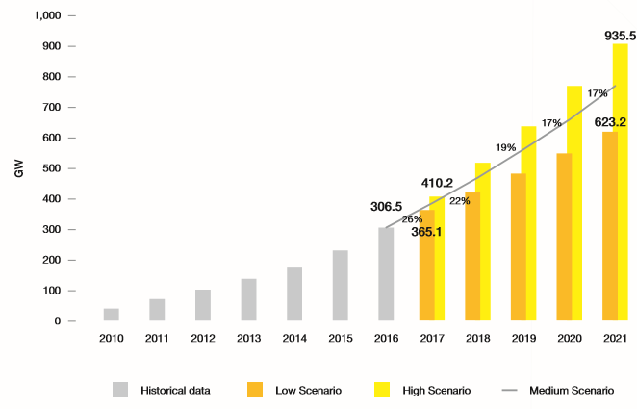
World Total Solar PV Market Scenario 2017-2021
300GW milestone was reached in 2016
exceed 400 GW in 2018
500 GW in 2019
600 GW in 2020
700 GW in 2021
（in medium scenario）
With the top 3 solar countries responsible for over 75% of global demand in 2016
（One major country’s policy
decision will affect ）
Steady Growth Rate Avg 15% in Solar over past 15 years !!!
+ 97 GW
+70 GW
+37 GW
Selected from Global Market Outlook for Solar Power/2017-2021

Slide 11
“three phase low power” dominates
All PV Modules
With 3 to 5 Bypass Diodes
Optimizer
µInverter
PV Module Level Power Electronics

Slide 12
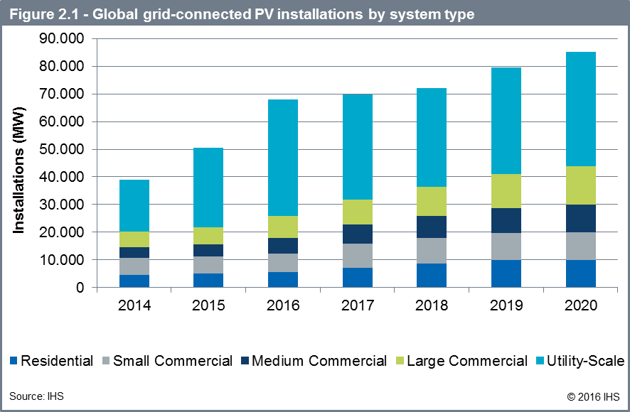
The world market for PV is mainly driven by utility Scale and Large Commercial Installations

Slide 13
Strong price decline continues, low and high power approach similar price line

Slide 14
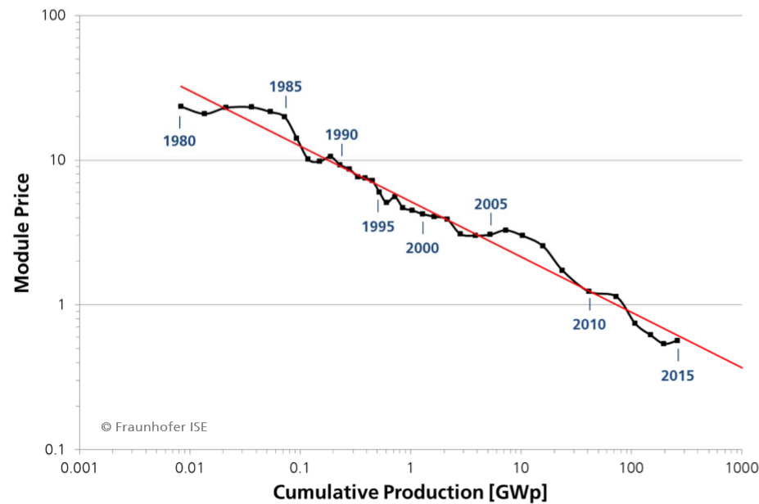
Prices trends for Solar PV module
The cumulative production
Doubled, the price went down by 23% for last 35 years
Ref: PHOTOVOLTAICS REPORT Frauhofer Institute for Solar Energy

Slide 15
Solar and energy storage are complementary and both are dropping in cost

Slide 16
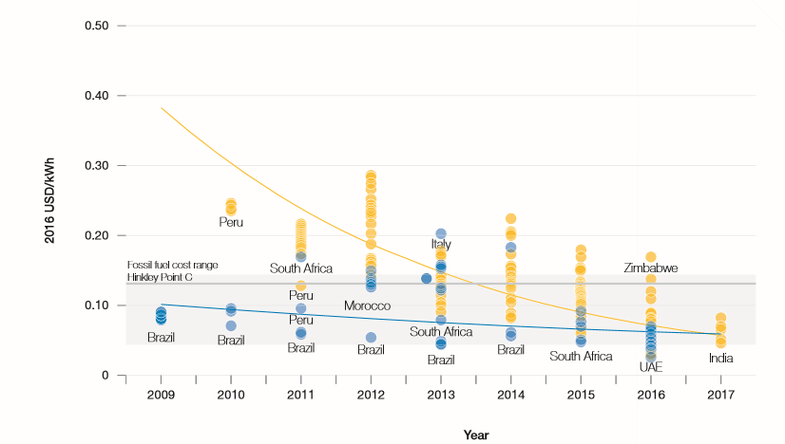

Prices for Solar PV and Wind Onshore Power Plants in Different Countries
2.4US cents/kWh : the world’s
Lowest solar supply contract
signed in 2016, Sweihan project
In UAE
Selected from Global Market Outlook for Solar Power/2017-2021

Slide 17
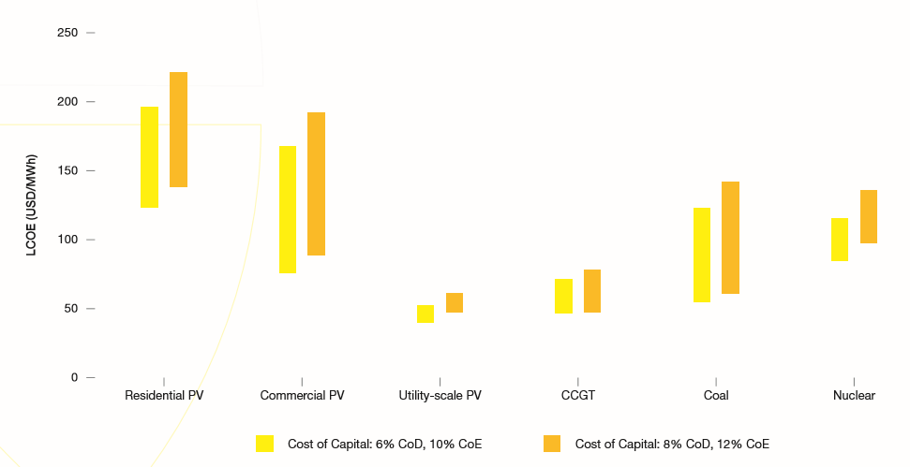
Solar Electricity Generation Cost in Comparison with Other Power Sources
Utility-scale solar is today already cheaper than new CCGT, coal and nuclear power plants.
When companies borrow funds from outside lenders, the interest paid on these funds is called the cost of debt
The cost of equity is inferred by comparing the investment to other investments (comparable) with similar risk profiles
Selected from Global Market Outlook for Solar Power/2017-2021
Notes:
Cost of Equity (CoE)
Cost of Debt (CoD)

Slide 18
Where the PV market heading?
The Past (2010)
The Present (2017)
The Future (2025+)
Deployment
Integration
PV Module Prices
$2-$3/W $0.37/W $0.23/W
Global PV Generation
10+ TWh 300+ TWh 2000+ TWh
Global PV Installations
10+ GW 300+ GW 1000+ GW

Slide 19
Market Trends: PV and Storage
Photovoltaic (PV) market is one of the fastest growing sub-segments of the semiconductor industry.
The increase in number of the large PV manufacturers pushed PV module price to less than $0.36/W.
Installed PV systems reached grid parity in many parts of the world.
Battery cost is following the same price reduction of PV.
Most of the investments to-date have been in the materials, inverters, battery, BOS sides with little efforts in the integration side to provide consumers with one complete, simplified architecture solution.
A paradigm change in the PV penetration will be fully enabled by integrating a battery to the PV system.
Adding Storage is the new mandated trend for many states and industries

Slide 20
Today’s Barriers
Battery + PV Integration has not taken off yet.
PV module improvements in efficiency and cost alone will not accomplish the revenue model
Other reasons:
Complex installation and Expensive Value Chain
PV Generation and Load Profile Mismatch
PV Intermittency
Battery Operation at high ambient Temperature

Slide 21
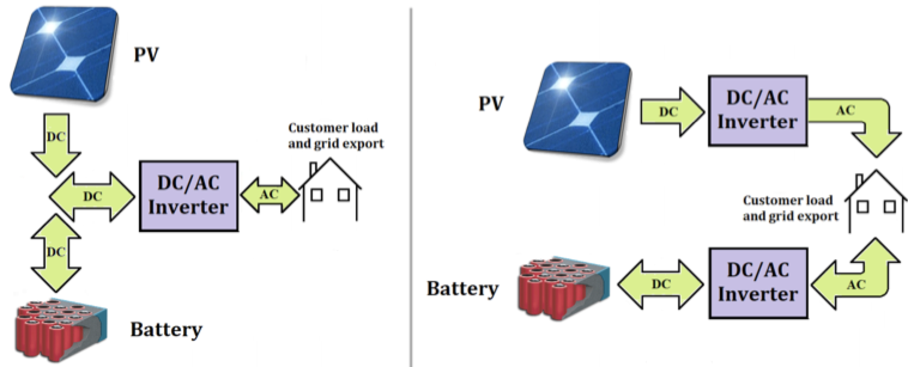
Current Solution Is Complex
DC-Coupled Configuration
AC-Coupled Configuration
Features:
Complex integration
Time Consuming
Costly
Reliability issues
Have Deployment
Barriers
Traditional Architecture for PV + Battery System
NREL: Installed Cost Benchmarks and Deployment Barriers for Residential Solar Photovoltaics with Energy Storage: Q1 2016

Slide 22
Simplified PV + Battery Supply Chain
DC
Maximizer
(optional)
HV and DC installations dictate professional installers by law
Module
Supplier
Inverter
Supplier
Professional
PV Wholesale
Other Discrete
Supplier
Professional
System Integrator
& Installer
End User
Professional
Battery
Wholesale
Battery
Supplier
Retail
Channel
PV System
Installer
Module
Supplier
iPV++ Module
Supplier
End User

Slide 23
Innovative Solution is Needed !
Targets:
One fully integrated product: PV, electronics and battery
Reduced installed cost …. Targeting $0.1/W and $200/kWh at 1C!
PV module improvements in efficiency and cost alone will not accomplish the revenue model
Systems that focuses on improving reliability, system efficiency and simplifying complexity
A system that results in significant cost reduction in installation and BOS to enable grid parity 24/7

Slide 24
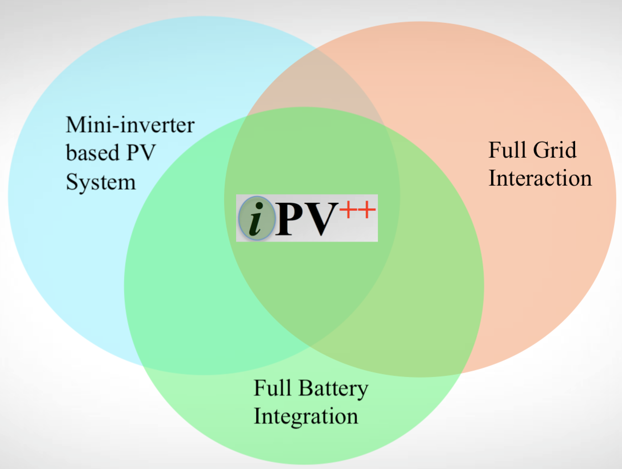
Our Proposed Solution
New Smart Integrated System

Slide 25
Our Proposed Solution
New Smart Integrated System
Battery
Integrated
Mini-Inverter

Slide 26
iPV⁺⁺ Module Block Diagram

Slide 27
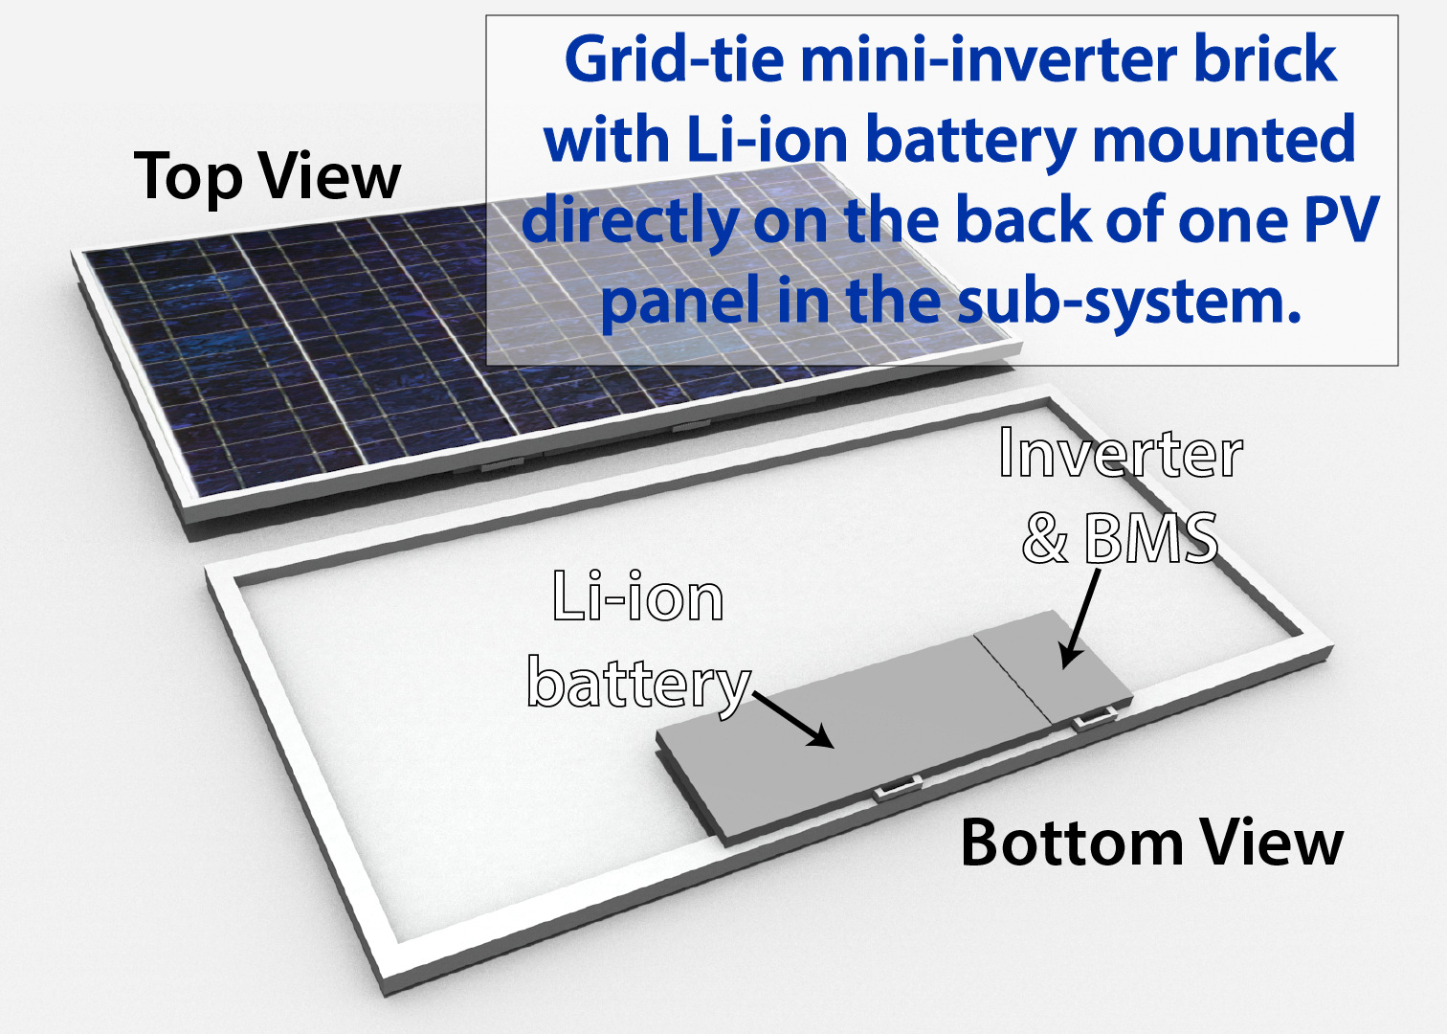
iPV⁺⁺: Integrated AC PV + Battery System
    Mini-inverter
      4-Panel input - DC/AC inverter
    Battery pack @1.2 kwh
    Two–Way wireless communications
      Highly distributed network
      Full grid-interaction
    Revenue grade metering
    Grid voltage sensors
    Flexibility in installation types
    Enables smart distributed solar
Notes:
Redraw the same panel but the back inverter is now iPV++ that covers bigger area.

Slide 28
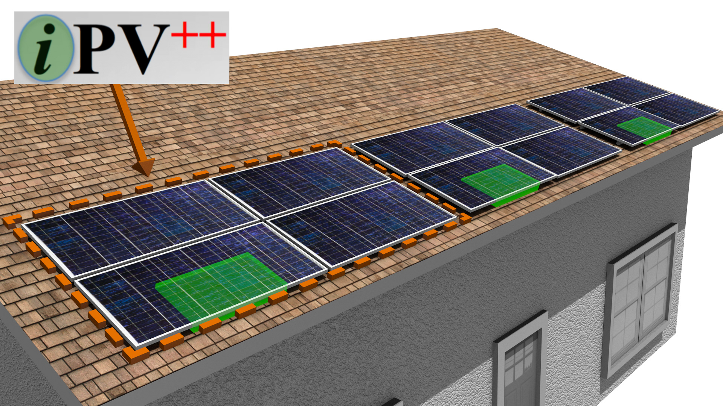

Slide 29
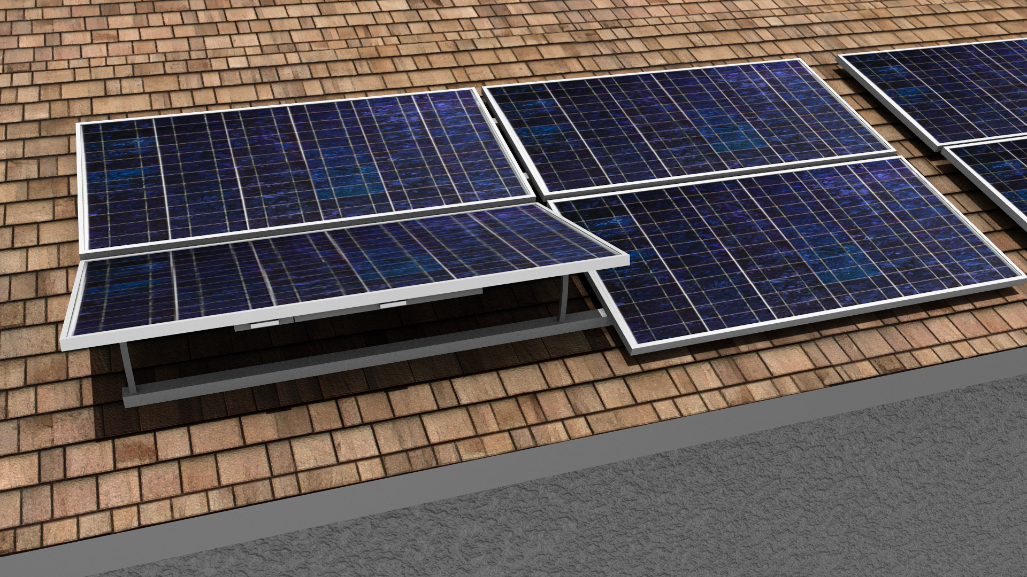

Slide 30
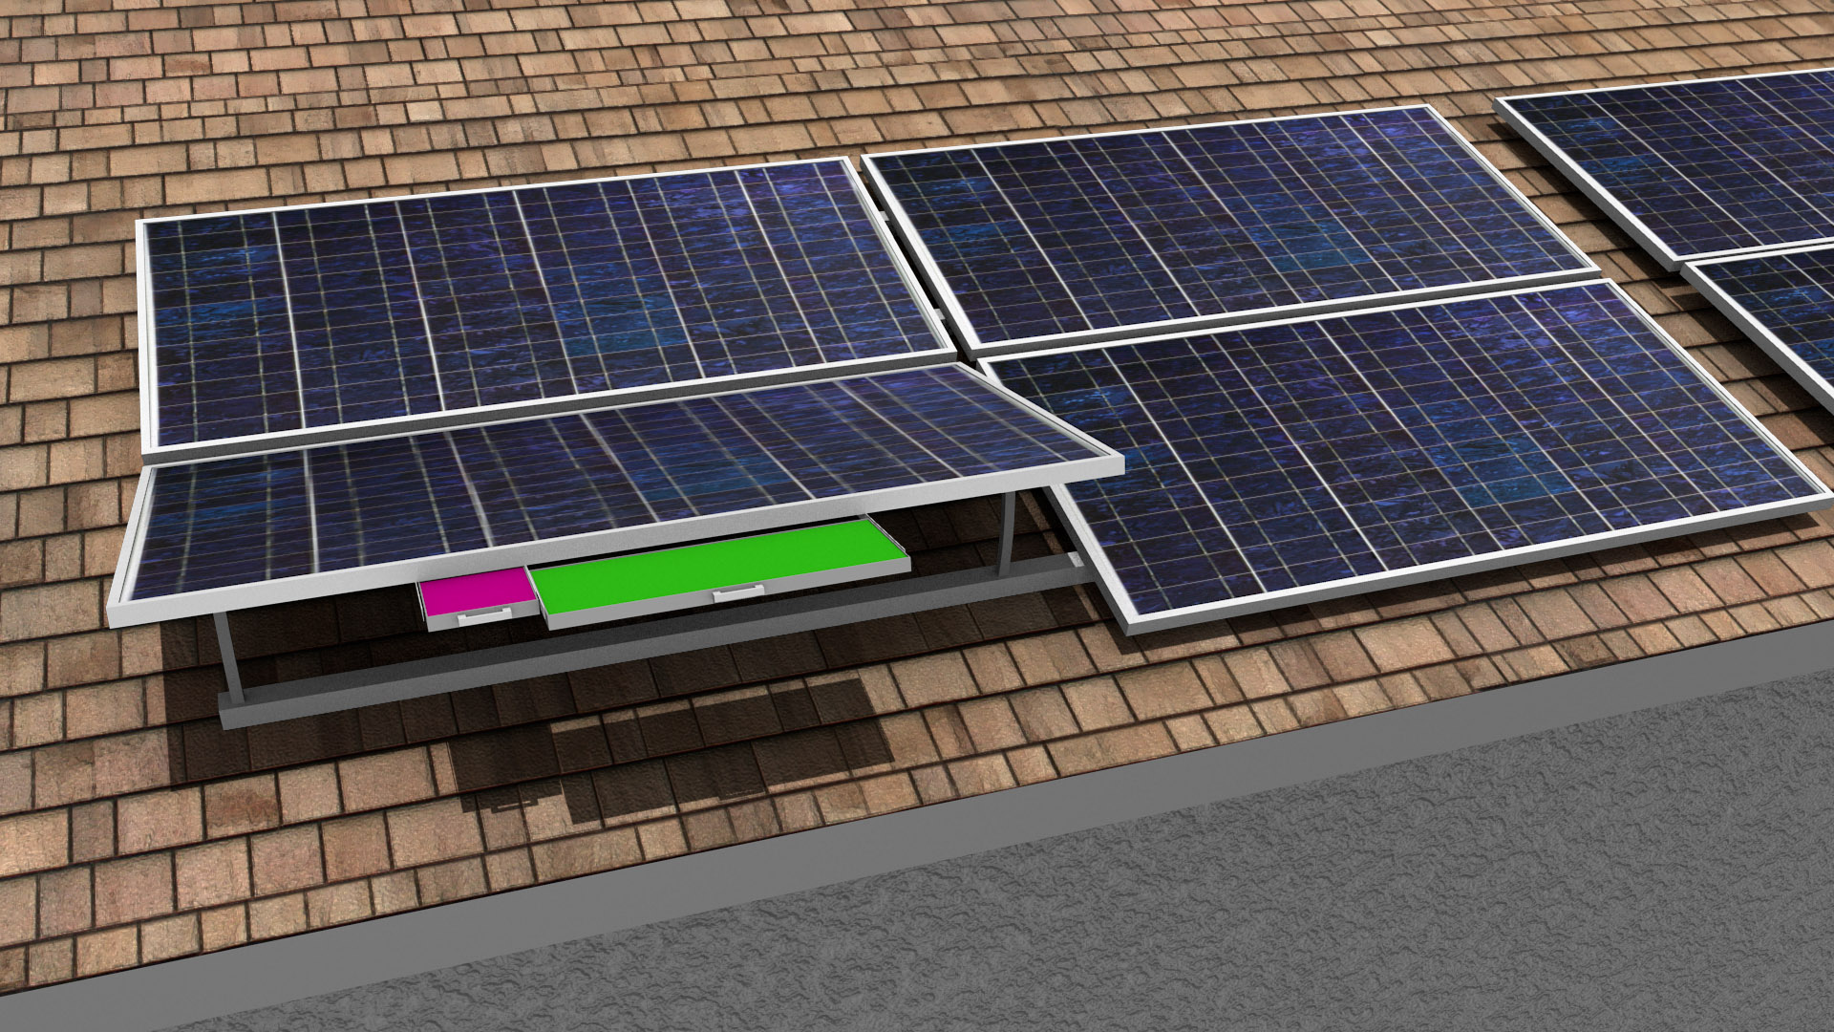

Slide 31
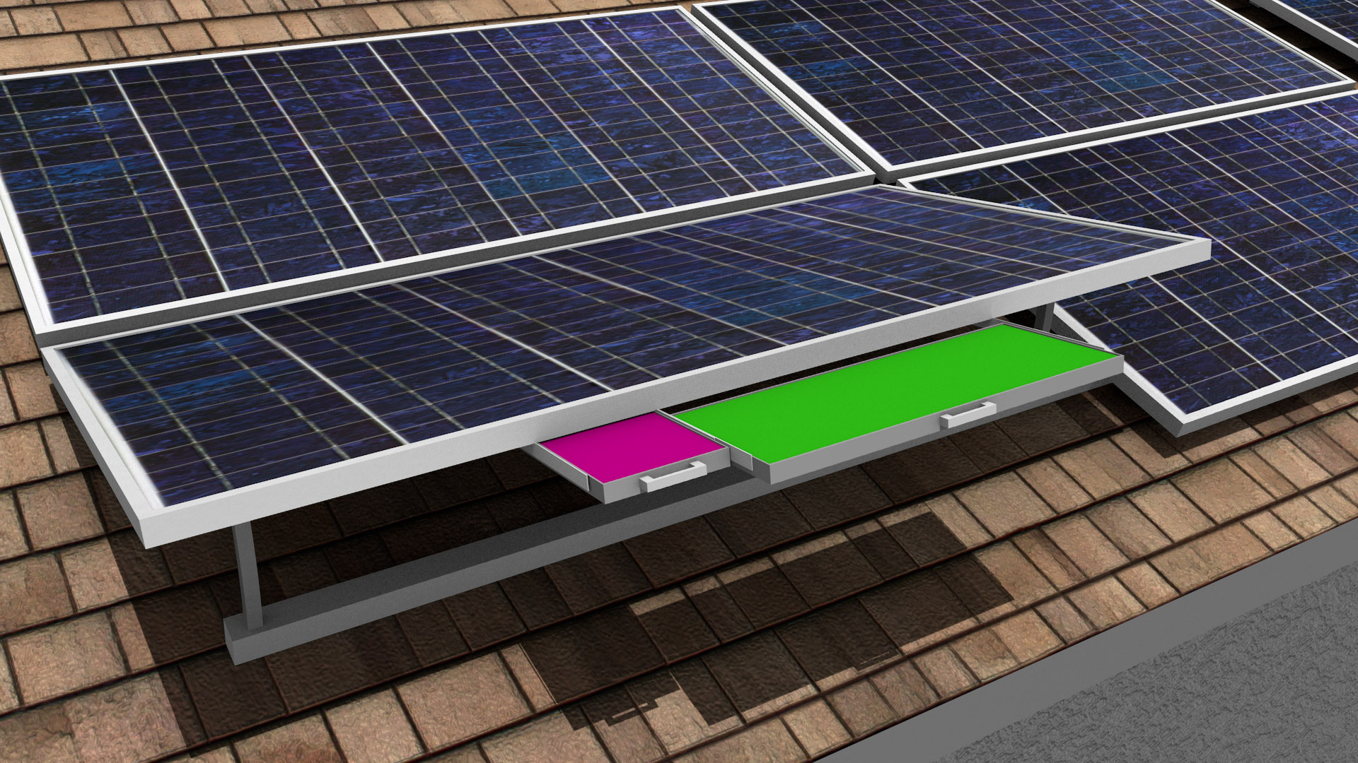

Slide 32
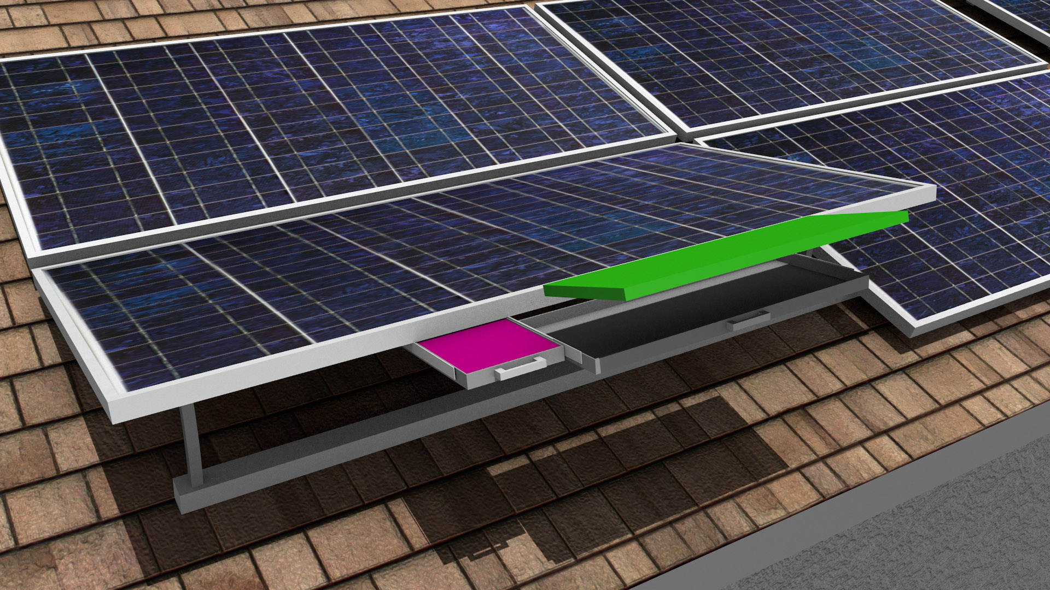

Slide 33
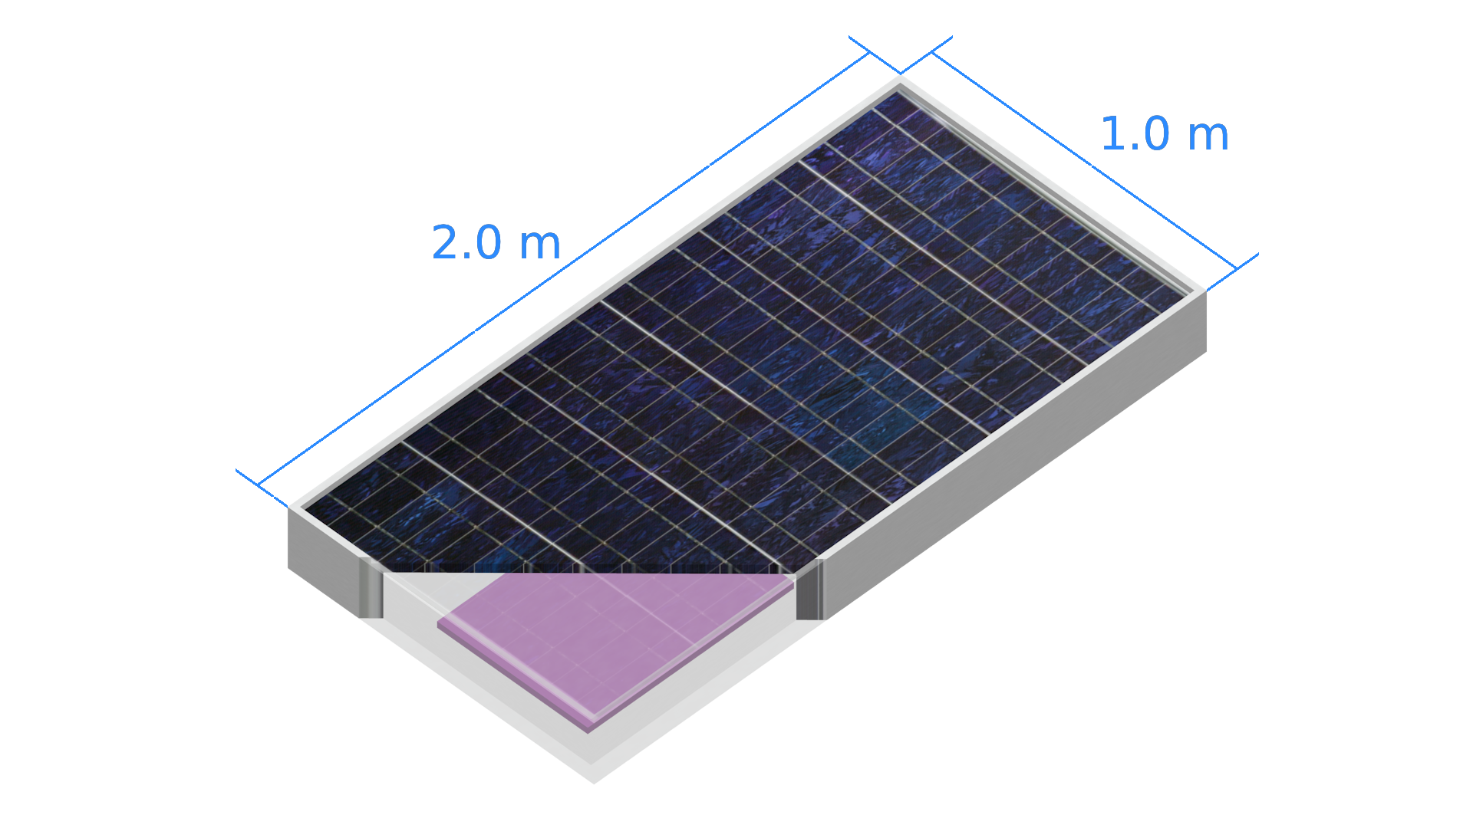
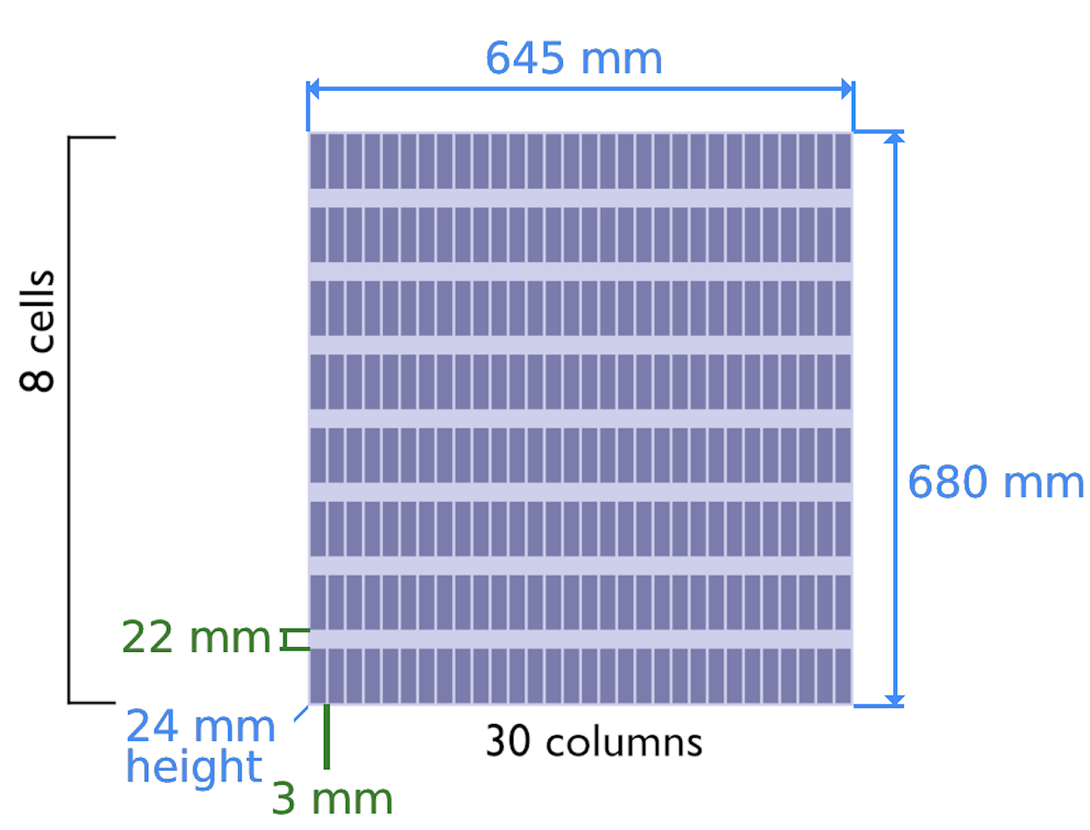
Battery Dimensions

Slide 34
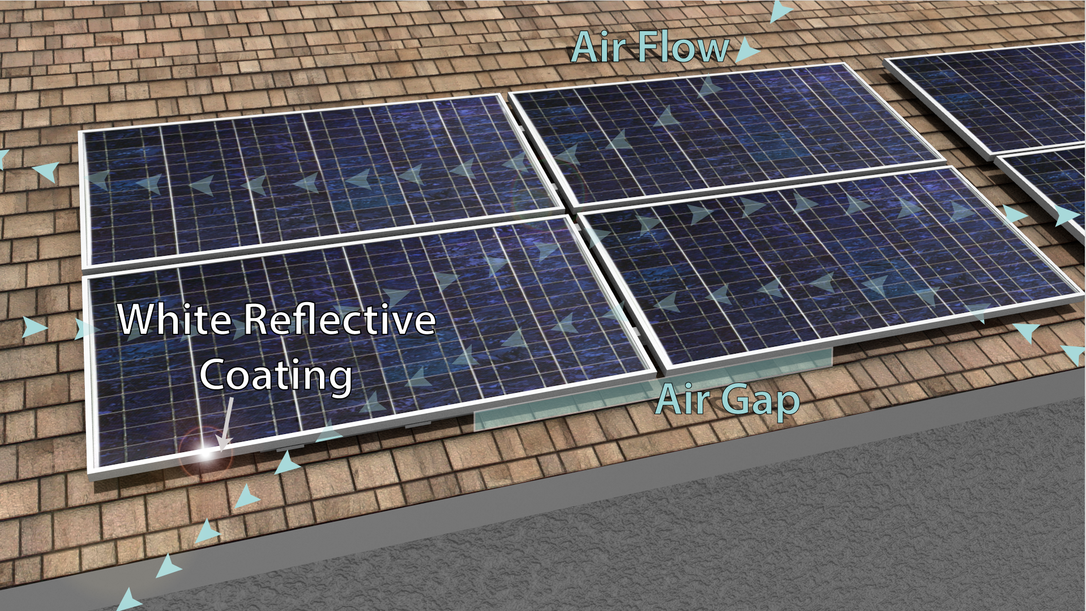

Slide 35
Mini-Inverter vs. String Inverter Architecture

Slide 36
Today’s PV System Architectures
The inverter technology drives the PV power system architecture
Presently, the market is dominated by:
  Centralized PV System
  String inverter PV systems
  Multi-string inverter systems & DC Optimizers
  Micro inverters: Single panel inverters & AC Modules
New PV system architectures can greatly impact overall PV system costs
  Mini-Inverters (new)

Slide 37
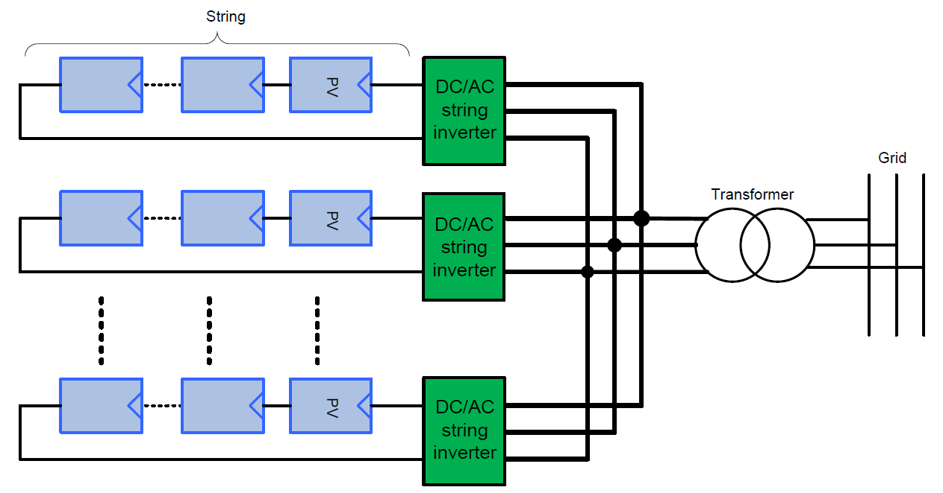
String inverter system architecture
Series String
Each PV module may not operate at its maximum power point which results in less energy harvested
Additional losses are introduced by string diodes and junction box
Single point of failure: and mismatch of each string or PV panel affects the PV array efficiency.
Hazardous: High-voltage strings → Arcing potential
Hazardous High Voltages: 600V – 1000 V
Complex system design: String sizing; module matching: direction, shading, ageing
Costly Installation: Special installation codes and procedures; certified installers
    DC disconnects and wiring conduit

Slide 38
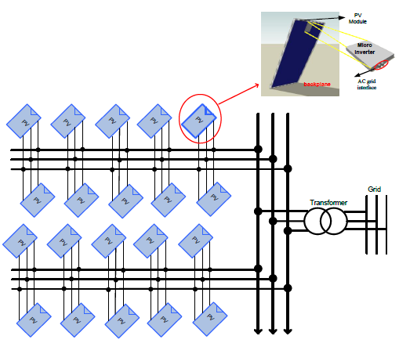
iPV⁺⁺ System Architecture and Module Benefits
Safe
No high voltage DC and DC losses
Smart
Monitor and control each panel
Reliable
No single point failure
Powerful
Maximum power for each panel
East to Install
Install & add one panel at a time
Simple
Design and installation
Modular
Scalable to any size installation
  NREL: Per panel system can reclaim 40%-100% of soiling losses -Technical Report: NREL/TP-5200-50003, 2011

Slide 39
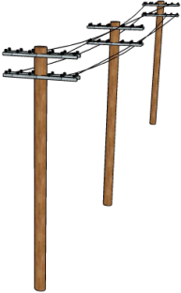
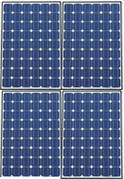
Increased Energy Harvest
String Inverter Mini Inverters
An example of distributed PV system
String
Inverter
Mini
Inverters
Micro inverters can realize upwards of 20-25% increased energy harvest

Slide 40

Increased Energy Harvest under Shading
String Inverter Mini Inverters
An example of distributed PV system
String
Inverter
Mini
Inverters
With string inverters, shading can reduce string output by 10% to 50%

Slide 41
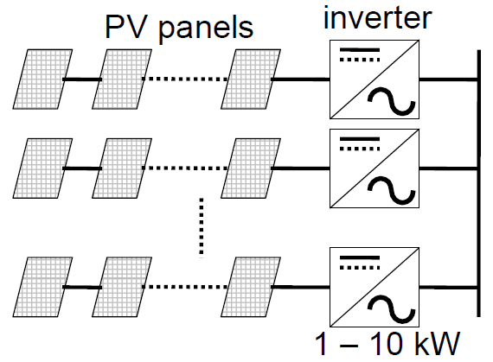
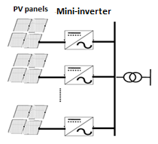
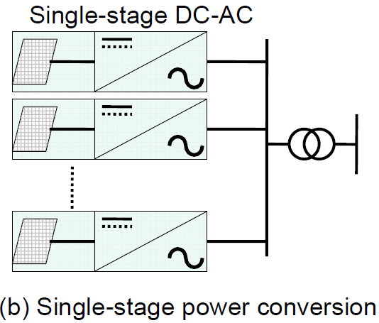
Comparison of PV System Configuration
String Inverter
Mini-Inverter
µ-Inverter
Medium size solar inverter configuration.
Series connected PV panels in a string that has its own inverter
Separate MPPTs
<10kW for residential and commercial applications
Four panels connected in parallel
Isolated Single mini-inverter per sub-system (4 panels)
1.2kW for residential application
Panel connect in parallel
Single inverter per panel
~250W for residential application
$0.12 - $0.18/W
$0.15 - $0.18/W
$0.3 - $0.4/W

Slide 42
Module and System Features

Slide 43
Why Proposing Our Systems ?
For Consumer:
  Faster ROI
  Increase PV consumption
  Combat Dynamic pricing
  Earning money with ancillary service
  Smart system ( cloud-based monitoring, remote access and control etc.)
  Emergency Back up with Grid forming inverters
  For System Operator & Utility:
  Energy Arbitrage
  Spin/Non-Spin Reserve
  Frequency Regulation
  Voltage Support
  Black Start
  Additional Power Distribution Deferral
  Transmission Congestion Relief
These advantage have not been only proven but already implemented for large buildings.
It will be brought to the Residential
Notes:
Talk about fact Battery are projected to be cheap.

Slide 44
:Differentiating Features
Integrated DC Coupled Battery System
One Complete Solution - Plug & Play (Easy installation and management)
Firmed PV Capacity- making Solar source a controllable source
Dispatchable Power Capabilities
Time-Shift of PV Power
Capturing the Low-Voltage PV Power
Capturing the Clipped Energy at Maximum PV Power

Slide 45
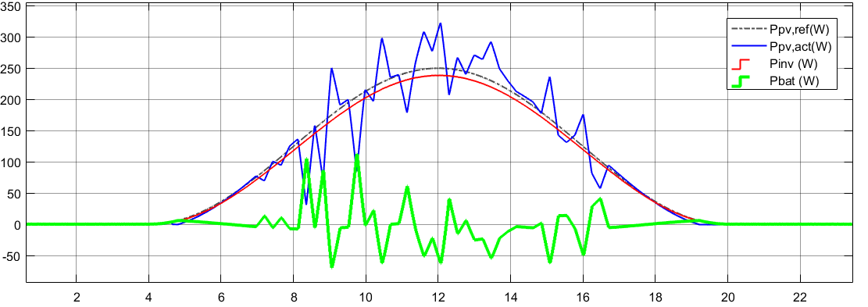
Firmed PV Capacity
Using battery to achieve PV firming

Slide 46
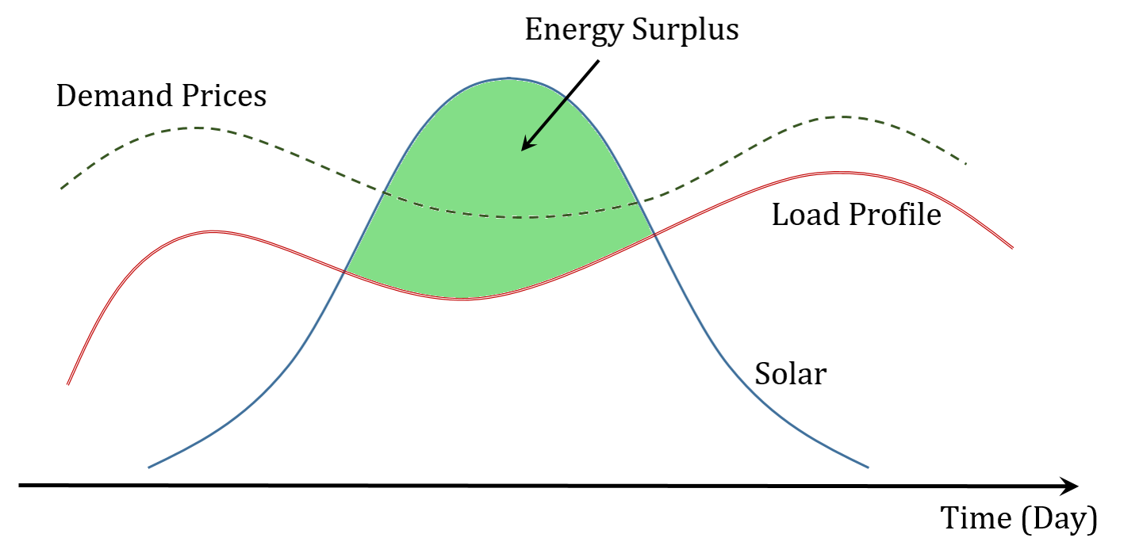
Time-Shift of PV Power
Energy Surplus
  Store
  Sell

Slide 47
Capturing the Low-Voltage PV Power

Slide 48
Capturing the Clipped Energy at Maximum PV Power

Slide 49
The Technology Differentiations
The technology will fully soft-switching topology to manage power harvesting and delivery with advanced control functionality.
Phase change materials that are integrated with the battery housing to improve safety under extreme weather conditions,
Battery on the roof integrated right with the PV system (no garage, basement wiring required)
Addressing the biggest obstacle in battery integration: Thermal Management and Safety.
Grid-tied system with bi-directional energy flow between the battery and grid
Unidirectional energy flow from PV to the battery and to the grid.
Modular-based, Grid-Interactive and Inverter with a unique rack system that makes installation and battery replacement much easier.

Slide 50
Detailed Specifications
First Stage: The Four PV and DC-DC Channels, each @ 300W with MPPT
Intermediate Stage: Bi-directional isolated DC-DC converter @ 1.2kW
Final stage: DC-AC (Inverter)
Battery Port: Bi-Directional DC-DC converter @ 1.2kWh
Battery, Li-ion @ 52V DC bus
Targeted System efficiency: 96%.

Slide 51
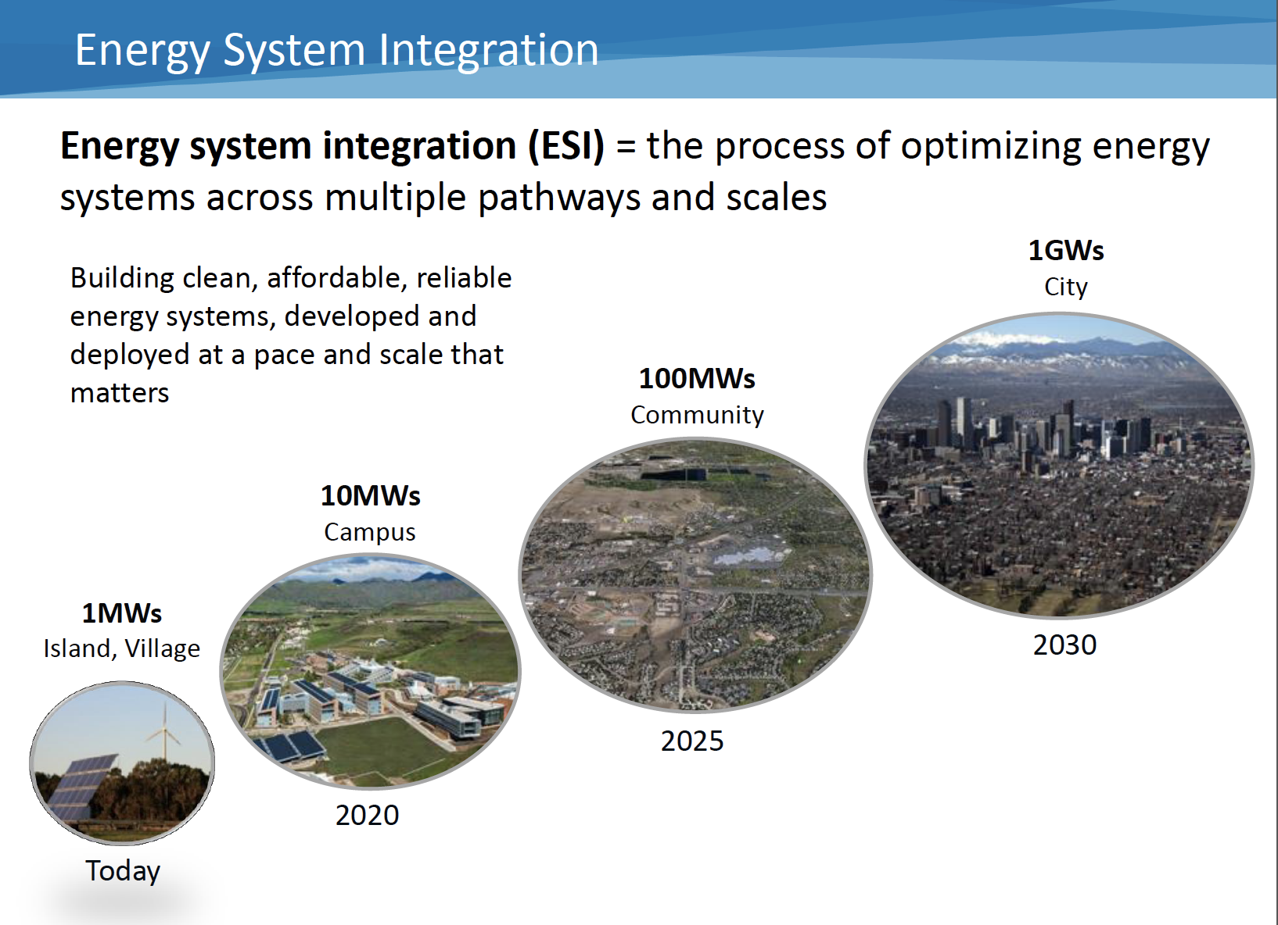
Courtesy of NREL

Slide 52
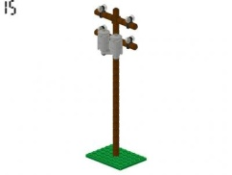
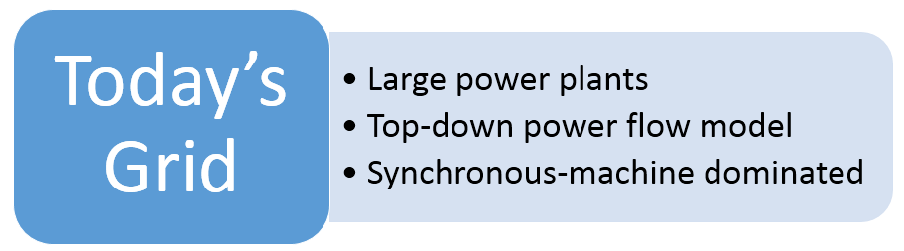
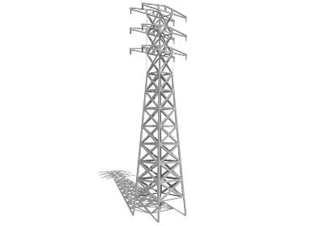
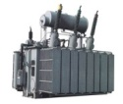



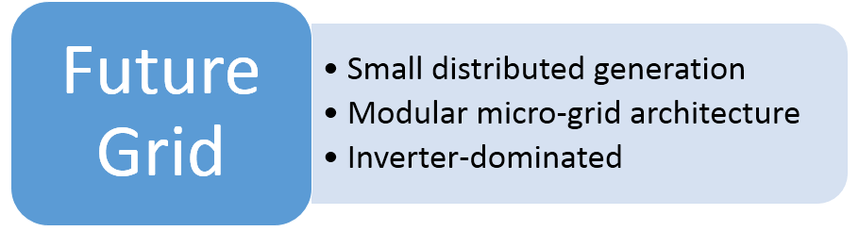
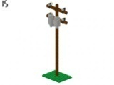

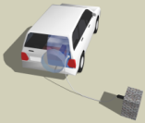
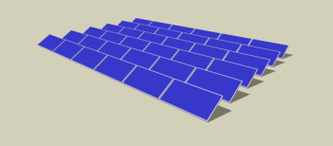


Grid Evolution
Power Plant
Distribution
Substation
Transmission
PHEV
PHEV
Courtesy of Petra Systems

Slide 53
Grid Evolution
Power Plant
Distribution
Substation
Transmission
PHEV
PHEV
Courtesy of Petra Systems
Opportunity for innovation

Slide 54
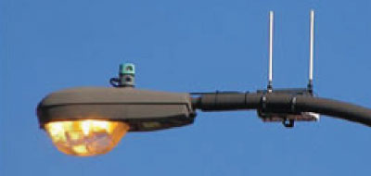
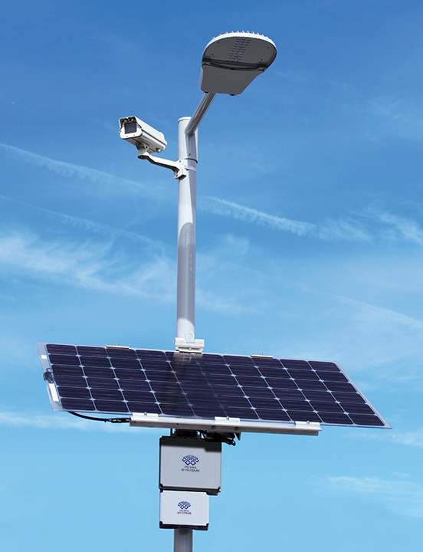
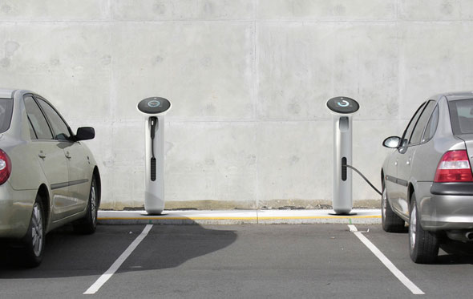
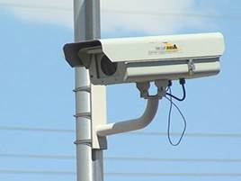
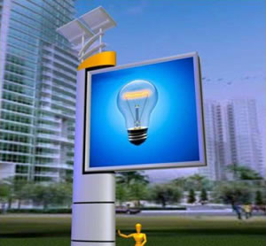
Smart and Sustainable…..
Green was the megatrend of the last 10 years
Smart is the emerging leading trend for the next 10 years
A $72 billion LED Retrofit + Pole Mounted Solar market in the US
The global smart city technology revenue (hardware, software, and services) will grow from $8.8 billion annually in 2014 to $27.5 billion in 2023
  26 global smart cities by 2025
  90 global sustainable cities by 2025
  20% growth in smart energy sector by 2020
Source: Navigant Research

Slide 55
Summary
Photovoltaic (PV) market is one of the fastest growing sub-segments of the semiconductor industry.
The increase in number of the large PV manufacturers pushed PV module price to less than $0.34/W.
Installed PV systems reached grid parity in many parts of the world.
Technology continues to improve in cost, performance and reliability.
Smart solar energy conversion and battery integration technologies have progressed tremendously
The integration of solar and ICT (smart-solar) to drive the future of smart grid is of utmost importance.
Battery cost is following the same price reduction of PV.
A paradigm change in the PV penetration will be fully enabled by integrating a battery to the PV system.
Adding Storage is the new mandated trend for many states and industries.
PV modules continue their sharp decline in price from the second half of 2016 with many analysts estimating module ASP to be around $0.35/W.
LED retrofits when combined with smart solar make economic sense.

Slide 56
Thank you
Battery Integration is the future wave of innovation!
"I'd put my money on the sun and solar energy. What a source of power! I hope we don't have to wait till oil and coal run out before we tackle that."
Thomas Edison

Slide 57
Dr. Issa Batarseh
Issa.batarseh@ucf.edu
+1407-962-8630

