Slide 1

The Effectiveness of Simulation-Based Education on Educational Practices of Communication Skills, Satisfaction, and Self-Confidence Among Undergraduate Nursing Students
Dr. Samar Jallad, PhD , RN
Assistant Professor in Nursing Education
Nursing Department
Faculty of Health Professions
Al-Quds University

Slide 2
1.
Introduction

Slide 3

The nursing education is an interesting and critical education field to create professional and highly qualified nurses in the society who have the required skills to solve and deal with the different health problems and issues that they confront .

Slide 4
2.
Simulation definition

Slide 5
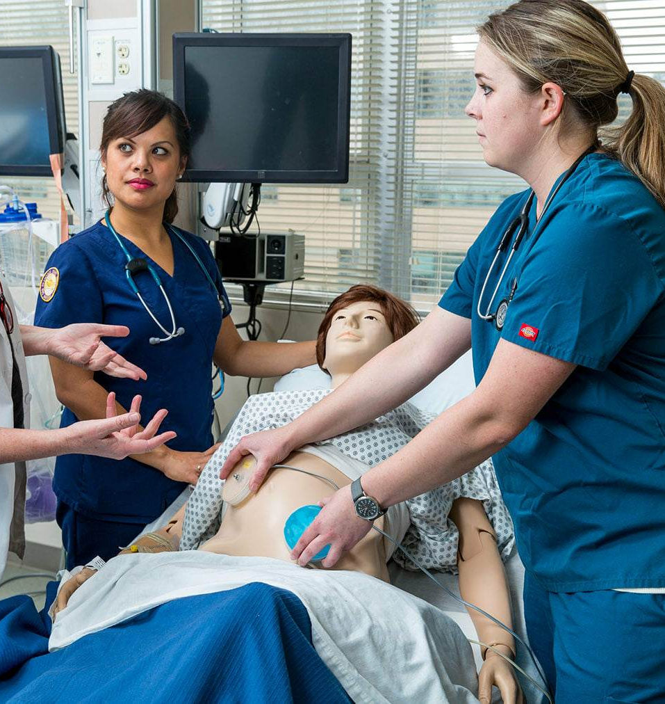
Simulation is a highly effective method used to create realistic characteristics that closely resemble real-life settings and situations. It involves specific activities designed to mimic the clinical environment, aimed at demonstrating procedures and enhancing decision-making and critical thinking skills.

Slide 6
3.
Important of the simulation

Slide 7
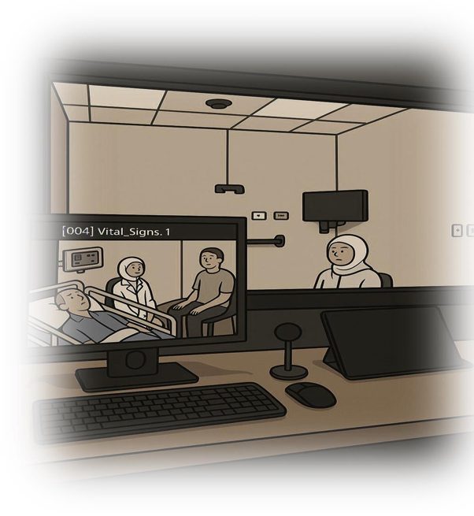
It is a teaching tool for education, training and improving the quality of student performance.
It is an assessment tool by assessing the student performance.
It is the best alternative solution to overcome the problems of using the real patient in the teaching such as: ethical and legal rights, and the lack of critical events that are source of learning.

Slide 8
4.
Communication And SBAR Definitions

Slide 9
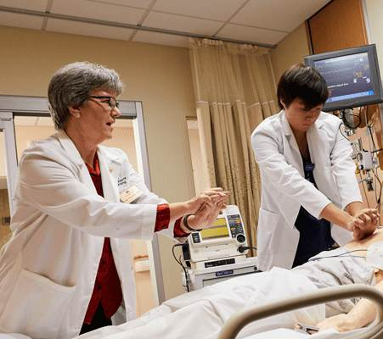
Communication: It is the process of sharing information using a set of common rules and it is a process by which information is exchanged between individuals through a common system of symbols, signs or behavior.

Slide 10
SBAR technique: is a tool that allows health professionals to communicate clear elements of a patient's condition. SBAR is a communication framework that facilitates the sharing of information between team members, encourages quick response times and places emphasis on providing quality care.

Slide 11
Situation
Background
Assessment
Recommendation

Slide 12
5.
Problem Statement

Slide 13
Clinical practical education conducted in hospitals suffers from a lack of work quality and proficiency.
Unexpected or extraordinary Clinical settings, where there is a shortage of human resources and equipment.
There is a shortage of instructors, as the number of nursing students is large and needs an appropriate number of experienced instructors.
Decrease Student’s satisfaction with their nursing practical education in clinical practice, and the opportunity to gain sufficient clinical competency through practical education is limited.

Slide 14
There is gap and deficiency in the nursing graduate student’s competencies and skills.
Poor communication skills In health care centers and hospitals.
Lack of studies and investigations that examine the effectiveness of simulation-based learning in developing communication skills for nursing students in Palestine.
There are a significant number of errors that nursing students make during clinical training in hospitals.

Slide 15
6.
Significance of the study

Slide 16
There is an increasing involvement and necessity for existence and development of simulation-based learning.
The simulated based learning and education gives the nursing students the opportunity to implement the learning, perceptual and psychological skills of learning.
support nursing students to obtain the required competencies and skills for efficient and successful thinking, and assessment.
Solving the various problems that they may expose to them in real conditions.
Improving their skills in making sound and accurate decisions.

Slide 17
7.
Aim of the study

Slide 18
To examine the effectiveness of simulation-based learning on the educational practice of communication skills, satisfaction, and self-confidence among undergraduate nursing students

Slide 19
8.
Ethical Consideration

Slide 20
The study data were collected from nursing students 1st year who enrolled basic nursing I to take part in the study after written permission from the al-Quds University Institutional Review Board (IRB) was obtained (Ref. No.: RESC/2023-39). An informed consent form was signed by the nursing students who agreed to participate in the study.

Slide 21
9.
Methodology

Slide 22
Study Settings: Nursing simulation lab Faculty of health since, Al-Quds University.
Study Design: Quasi experiment design (pre-posttest).
Population: Nursing students first class who enrolled basic nursing one (247 students).
Sample and sampling: The total population (149 students), Taking into consideration, those students entered the simulation laboratory for the first time.(The sample in the "Pre-PostTest" there were (112) students.

Slide 23
Data Analysis: the researchers used SPSS version (25) to analyze the obtained data from the investigated sample through using both descriptive and inferential statistics through using descriptive statistics through using means, standard deviation, frequencies, percentages. Them the researchers used t-test and ANOVA to answer the questions of the study, achieve its objectives and to examine the hypotheses of the study. Furthermore, the researcher used the Cronbach alpha to examine the reliability of the questionnaire.

Slide 24
10.
Data Collection Tool

Slide 25
Variable | Scale | Frequencies | Percentages
Gender | Male | 20 | 17.9
 | Female | 92 | 82.1
Age | less than 20 | 99 | 88.4
 | 20-24 | 10 | 8.9
 | More than 29 | 3 | 2.7
 | Total | 112 | 100.0
average | 90-100% | 12 | 10.7
 | 80-89% | 65 | 58.0
 | 70-79% | 33 | 29.5
 | Less than 69 | 2 | 1.8
 | Total | 112 | 100.0
place of residence | City | 70 | 62.5
 | Village | 36 | 32.1
 | Camp | 6 | 5.4
 | Total | 112 | 100.0
Type of study | Regular | 100 | 89.3
 | Upgrading | 12 | 10.7
 | Total | 112 | 100.0
Did you previously work as a nursing assistant or nursing aids | Yes | 20 | 17.9
 | No | 92 | 82.1
 | Total | 112 | 100.0
information technology skill level at enrollment | Non | 5 | 4.5
 | Limited | 32 | 28.6
 | Basic | 71 | 63.4
 | Advanced | 4 | 3.6
 | Total | 112 | 100.0
which digital tool used during course work | Computer | 27 | 24.1
 | Mobile Phone | 61 | 54.5
 | Tablet | 12 | 10.7
 | None | 12 | 10.7
 | Total | 112 | 100.0
Are you satisfied with your simulation based learning experience | Yes | 98 | 87.5
 | No | 14 | 12.5
 | Total | 112 | 100.0
Personal Information Form
The researchers utilized this tool as it combines the social and demographic characteristics of nursing students.
Demographic data:
Gender;
Age;
Average;
Place of Residence;
Type of study;
Did you previously work as nursing assistant or nursing aids;
Information technology skill level at enrollment;
Which digital tool used during course work;
Are you satisfied with your simulation-based learning experience?)

Slide 26
1-Educational Practices Questionnaire (Student Version)
This questionnaire was developed by the National Nursing Association (2005). The scale used in this study was adopted from a study conducted by Cheek and Gussone (1987), with a reliability coefficient of (0.91) in their study.
2-Student Satisfaction and Self-Confidence in Learning
This tool was developed by the National League for Nursing. The scale was adapted from a study conducted by Chickering and Gamson (1987).

Slide 27
11.
Findings

Slide 28
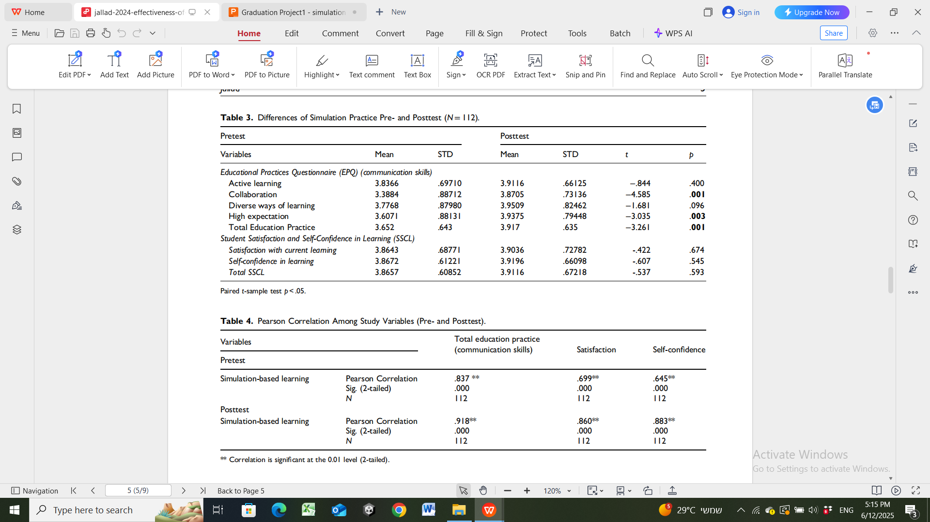

Slide 29
12.
Discussion

Slide 30
The results indicate that the essential features of educational practice after simulation sessions for communication skills were arranged as follows:
firstly, diverse ways of learning; then, high expectations and active learning; and finally, collaboration.
There was a significant difference between collaboration and high expectations.
These results may be attributable to dynamics and complexity in a clinical environment, in which communication and efficient teamwork among health-care professionals are important to meet the needs of patients and collaboration takes place in all stages of the nursing process to achieve desired outcomes (Granheim et al., 2018).

Slide 31
simulation is considered an effective approach to improving collaborative skills for nursing students to meet learning objectives (Foster et al., 2019).
In this study to enhance students’ collaboration and awareness in educational practice simulation, the different roles and scenarios were designed and prepared in the simulation onstandard patients, which takes place through distributed role play among students; students were told that teamwork is common in clinical practice and that team support and collaboration can affect efficiency, cooperation, communication, and leadership, which agrees with the findings of Grover et al. (2017) and Mohamed and Mohamed (2020).

Slide 32
13.
Conclusion

Slide 33
Simulation-based learning in nursing helps students to:
Increase enhance communication skills between students.
Accurately analyze data in real-life situations.
Acquire essential competencies and skills.
Make informed decisions
Simulation-based education enhances patient safety and their health by:
Simulating real-life patient conditions.
Facilitating problem-solving in clinical scenarios
Avoiding patient exposure to risks.

Slide 34
References

Slide 35
Ahmed, E. S., Hassan, A. M., & Mehany, M. M. (2019). Effect of Simulation on Critical Thinking, Satisfaction and Self-Confidence of Nursing Students During Care of Pneumonic Child. International Journal of Advance Research in Nursing, 2(1), 131-137.
Albelbeisi Ah, Albelbeisi A, El Bilbeisi Ah, Taleb M, Takian A, Akbari-Sari A. (2021). Public Sector Capacity to Prevent and Control of Noncommunicable Diseases in Twelve Low and Middle-Income Countries Based on Who-Pen Standards: A Systematic Review. Health Services Insights. 2021; 14:1178632920986233
Azizi, M., Ramezani, G., Karimi, E., Hayat, A. A., Faghihi, S. A., & Keshavarzi, M. H. (2022). A Comparison of the Effects of Teaching Through Simulation and the Traditional Method on Nursing Students' Self-Efficacy Skills and Clinical Performance: A Quasi-Experimental Study. Bmc Nursing, 21(1), 1-8. ‏

Slide 36
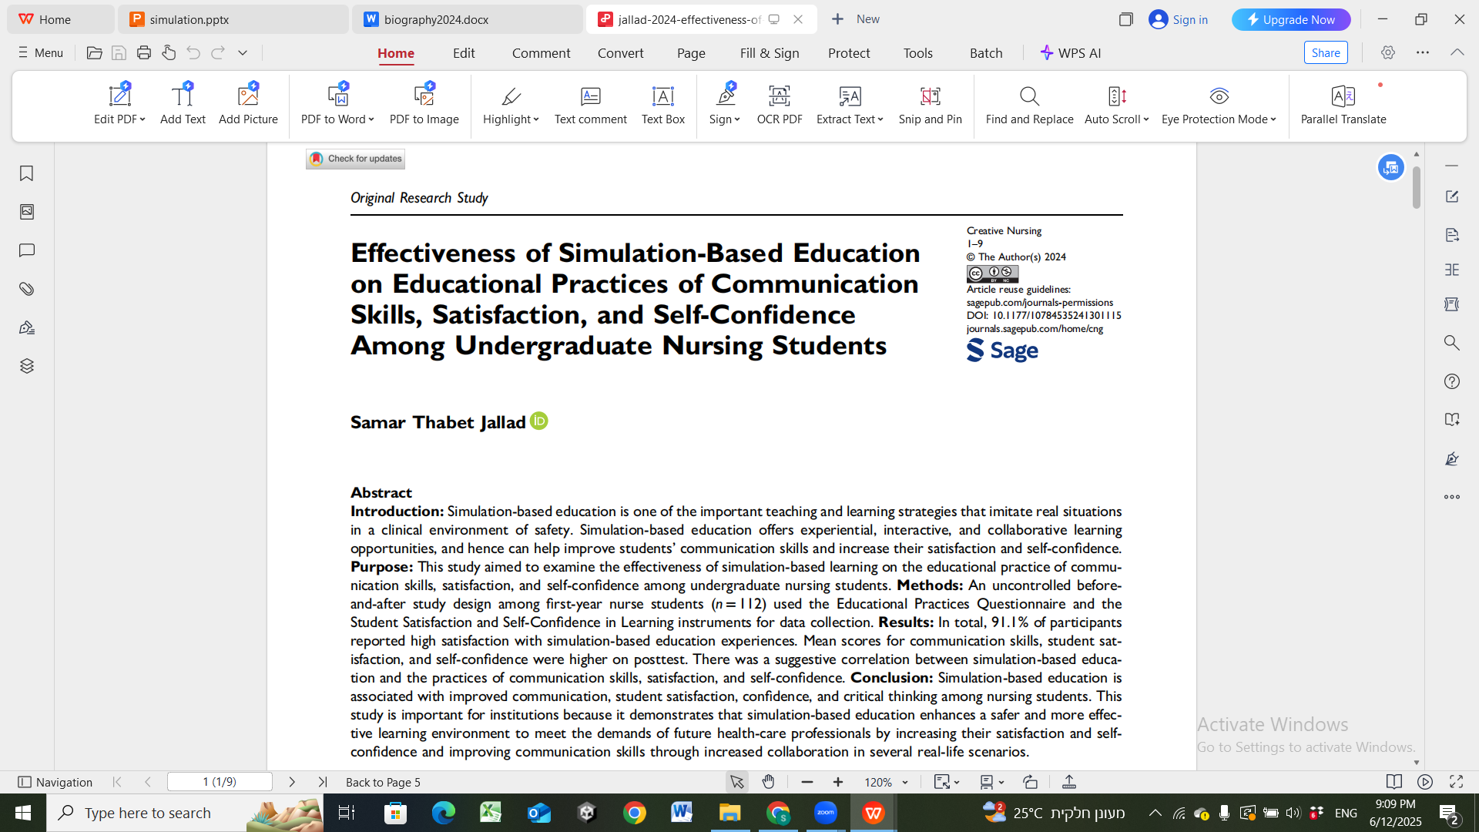
THANK YOU

