Slide 1
The science, politics and economics of
climate change
AQU Guest
Al-Quds University, Abu Dis, Palestine

Slide 2
The topics of discussion
The science
What is climate?
Observations of climate change.
Increasing greenhouse gases.
Are greenhouse gases really the explanation?
How is present different from the past?
Politics of climate change
Which countries are responsible and who should pay?
Economics and climate change
How economic growth and climate change are intimately related.
Impacts in Palestine
Extreme events and Health.
Extreme events and Conflict.
The psychology of (lack of) climate action
No clear external “enemy”.
We are all responsible.

Slide 3
First things first:
Climate is different from weather

Slide 4
Climate is different from weather
Climate vs weather
Climate: carry your rain jacket from December to February.
Weather: do you have to use your jacket on 20th January?

Slide 5
Climate is different from weather
Climate vs weather
Climate is average weather.

Slide 6
Observations of climate change

Slide 7
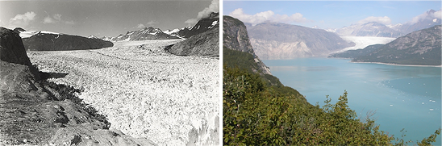
Glacier retreat on “White Thunder Ridge”, Alaska
Observation of climate change
1941
2004
https://nsidc.org/cryosphere/sotc/glacier_balance.html
Notes:
Glacier Bay National Park and Reserve's White Thunder Ridge as seen on August 13, 1941 (left) and August 31, 2004 (right). Muir Glacier has retreated out of the field of view, Riggs Glacier has thinned and retreated significantly, and dense new vegetation has appeared. Muir Glacier was more than 2,000 feet thick in 1941. 2004 USGS photo by B.F. Molnia; 1941 photo by W.O. Field. See Repeat Photography of Glaciers in the Glacier Photograph Collection to access this and other photograph pairs.

Slide 8
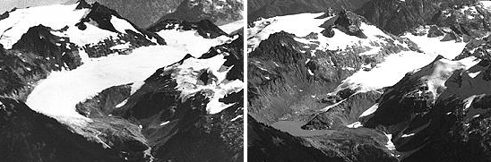
Glacier retreat in “South Cascade Glacier”, Washington
Observation of climate change
1928
2000
https://nsidc.org/cryosphere/sotc/glacier_balance.html
Notes:
These photos of the South Cascade Glacier in the Washington Cascade Mountains show dramatic retreat between 1928 and 2000. Photos courtesy USGS.

Slide 9
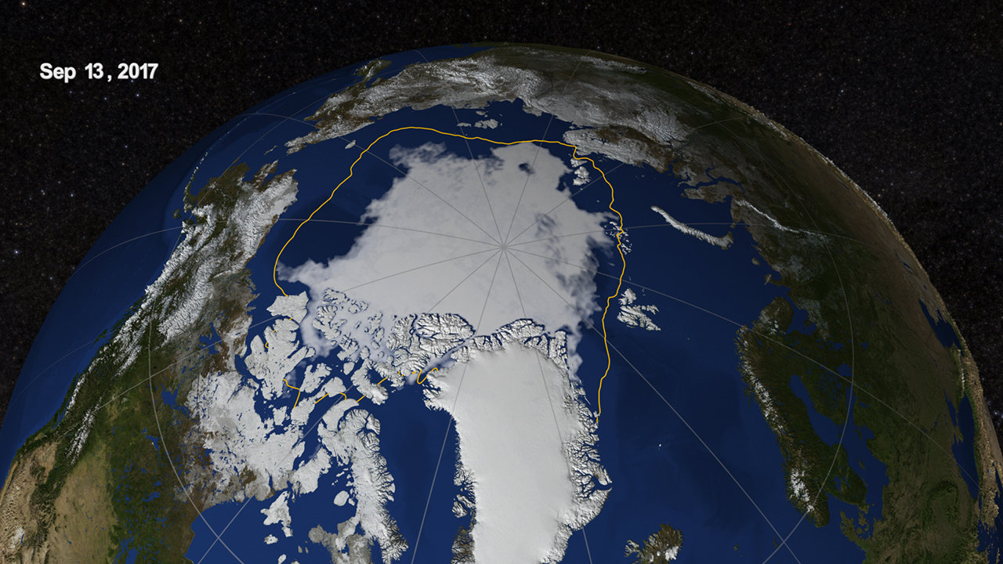
Arctic summer sea ice extent
Observation of climate change
https://climate.nasa.gov/news/2633/end-of-summer-arctic-sea-ice-extent-is-eighth-lowest-on-record/
Notes:
A still image of the Arctic sea ice on Sept. 13, 2017, when the ice reached its annual minimum. In addition, a yellow line marks the 30-year average minimum sea ice extent computed over the time period from 1981 through 2010.

Slide 10
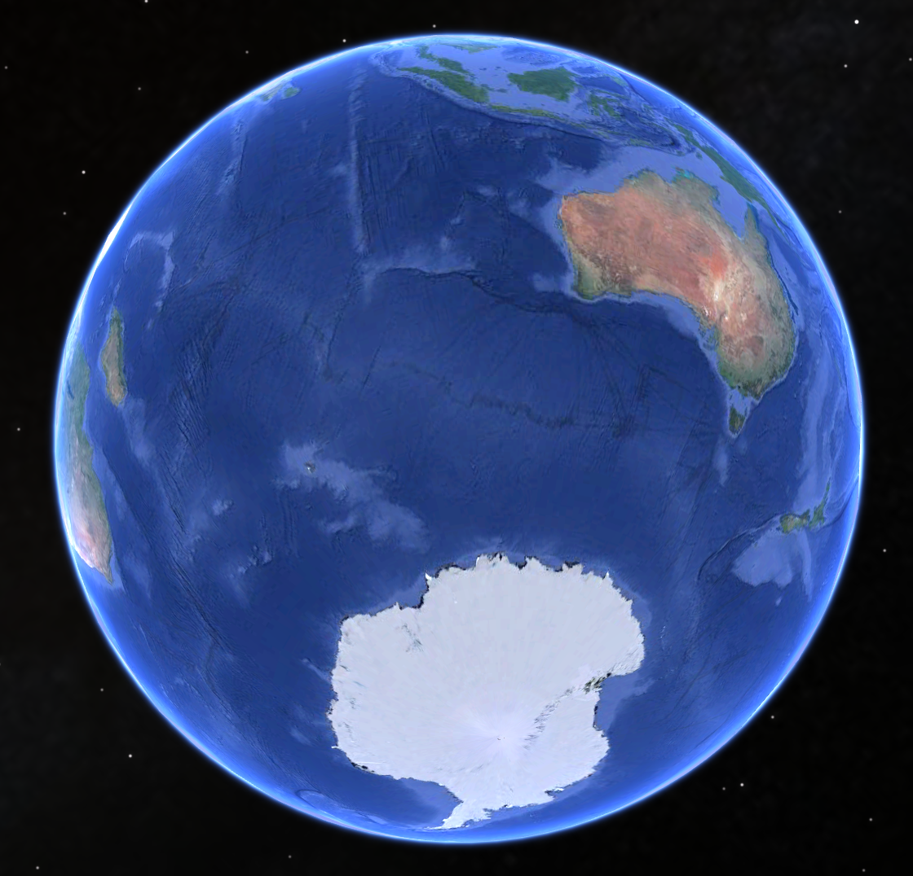
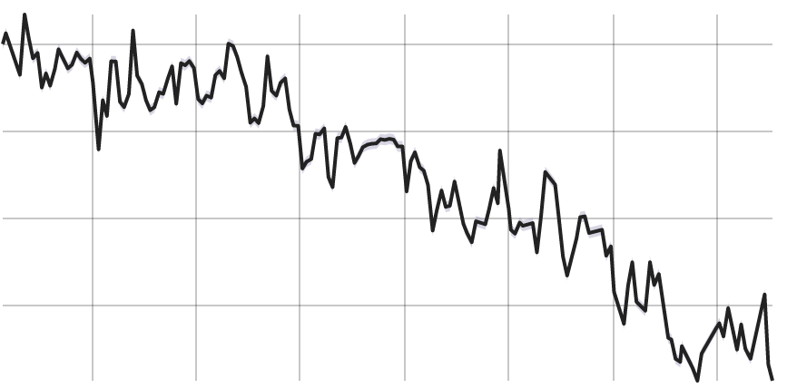
Antarctic ice is reducing
Observation of climate change
0 Gt
Ice mass
- 2000 Gt
2002
2017
Year
Source: NASA satellite measurements (GRACE).

Slide 11
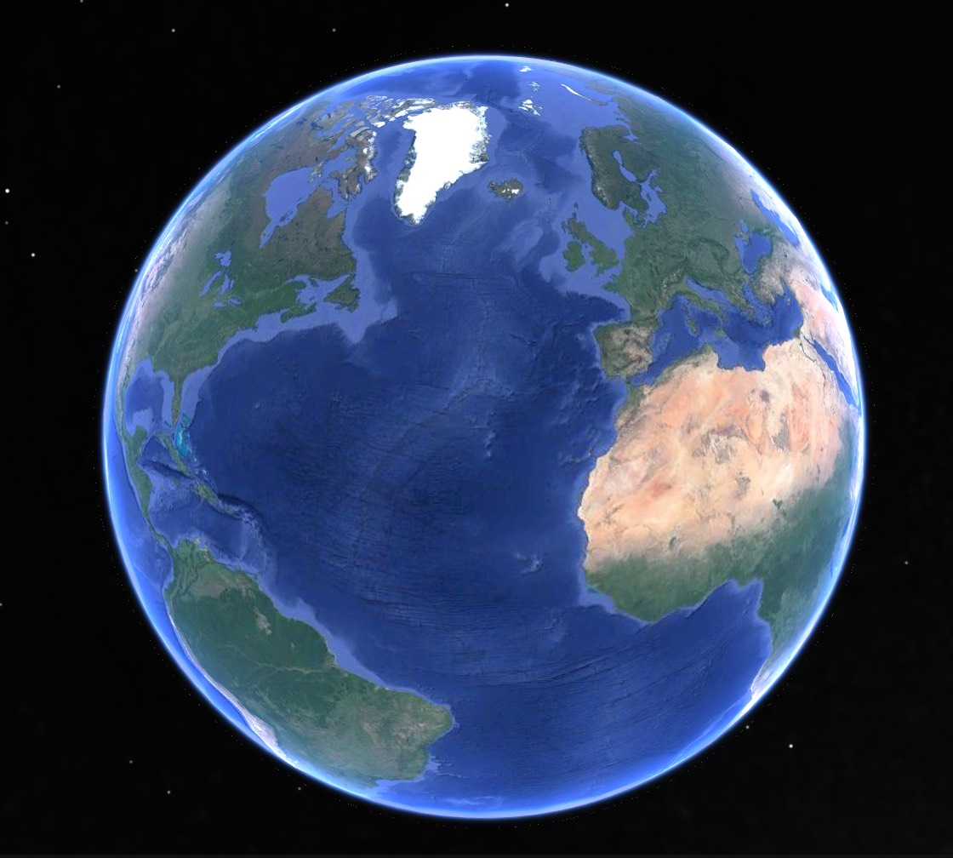
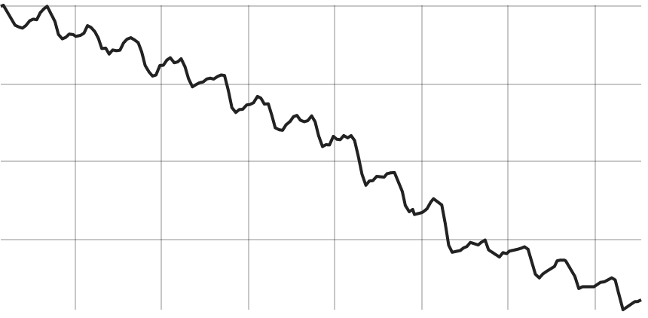
Greenland ice is reducing even faster
Observation of climate change
0 Gt
Ice mass
- 4000 Gt
2002
2017
Year
Source: NASA satellite measurements (GRACE).

Slide 12
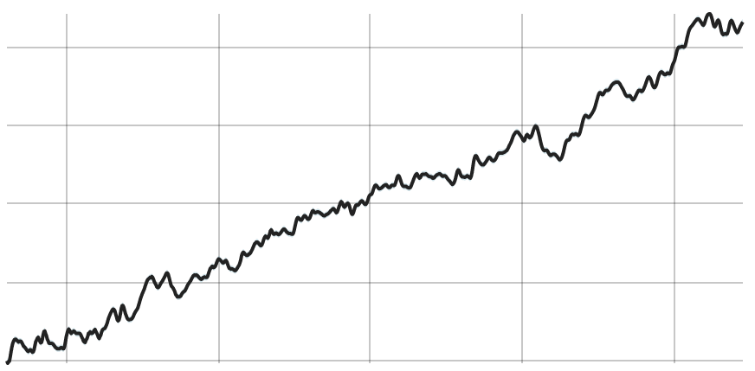
Sea level rise from Satellite observations
Observation of climate change
80
Sea level rise (mm)
0
1993
2016
Year
Source: NASA Goddard Space Flight Center
Notes:
https://climate.nasa.gov/
Sea levels have risen almost 18cm in the past 100 years.

Slide 13
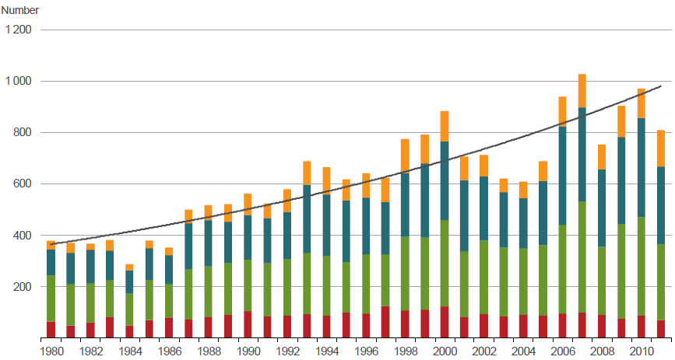
Extreme events are increasing worldwide.
Observation of climate change
Munich Reinsurance Company

Slide 14
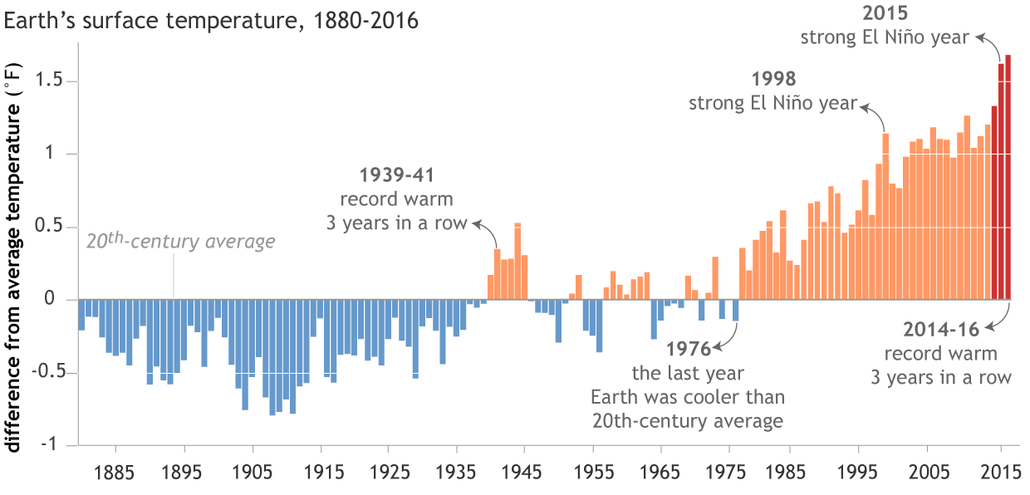
Global temperatures from 1880 to 2016
Observations of changing climate
Temperature rise
(º F)
Year
Data: NOAA

Slide 15
What are we humans doing?

Slide 16
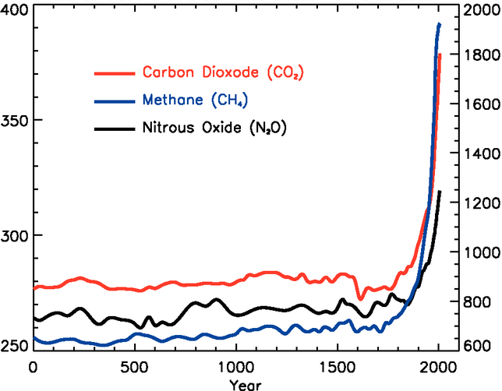
Increase in greenhouse gases in the past 2000 years
What’s different today?
Methane
(ppb)
Carbon Dioxide (ppm)
Nitrous Oxide (ppb)
Carbon Dioxide
Nitrous Oxide
Methane
IPCC 2007
Notes:
Till 2005.

Slide 17
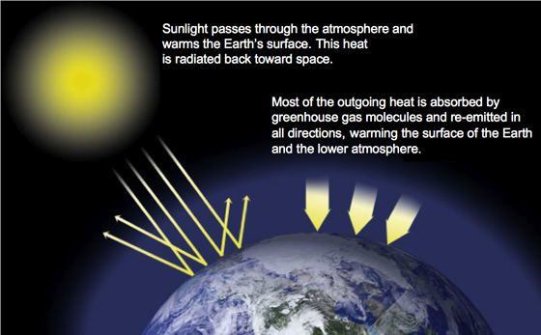
Greenhouse gases cause heating (quantum mechanics)
What’s different today?
NASA graphic
Notes:
: https://climate.nasa.gov/system/content_pages/main_images/1_normPage-3.jpg

Slide 18
Is the effect of greenhouse gases strong enough to explain current climate change?

Slide 19
Climate change: natural variation or human intervention?
Climate change attribution
Natural variations:
    Change in solar output?
    Orbital changes?
    Volcanic eruption?
Human intervention:
    Forest -> Agriculture?
    Aerosol injection?
    Greenhouse gases?

Slide 20
How does attribution work?
Climate change attribution
Bloomberg graphics of climate change
https://www.bloomberg.com/graphics/2015-whats-warming-the-world/

Slide 21
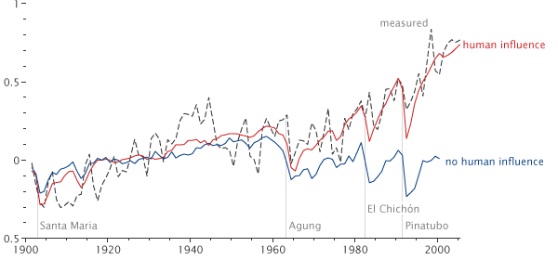
Recent rise in temperature cannot be explained without accounting for observed greenhouse change
Climate change attribution
Temperature
Rise (ºC)
Adapted from Hegerl et.al. 2007.
Notes:
This graph shows two simulations of 20th century global mean temperatures compared with observed temperatures (dotted line). The red line (higher up on the right-hand side graph) shows simulated temperatures including human influences (e.g., greenhouse gases and aerosols), the blue line (lower down on the right-hand side graph) shows simulated temperatures excluding human influences. The graph is adapted from Hegerl et al. (2007) (referred to by the cited source).
From the cited Lindsey (2010) public-domain source: "Reconstructions of global temperature that include greenhouse gas increases and other human influences (red line, based on many models) closely match measured temperatures (dashed line). Those that only include natural influences (blue line, based on many models) show a slight cooling, which has not occurred. The ability of models to generate reasonable histories of global temperature is verified by their response to four 20th-century volcanic eruptions: each eruption caused brief cooling that appeared in observed as well as modeled records." For more information, see attribution of recent climate change.

Slide 22
How is climate change today different
from the past?

Slide 23
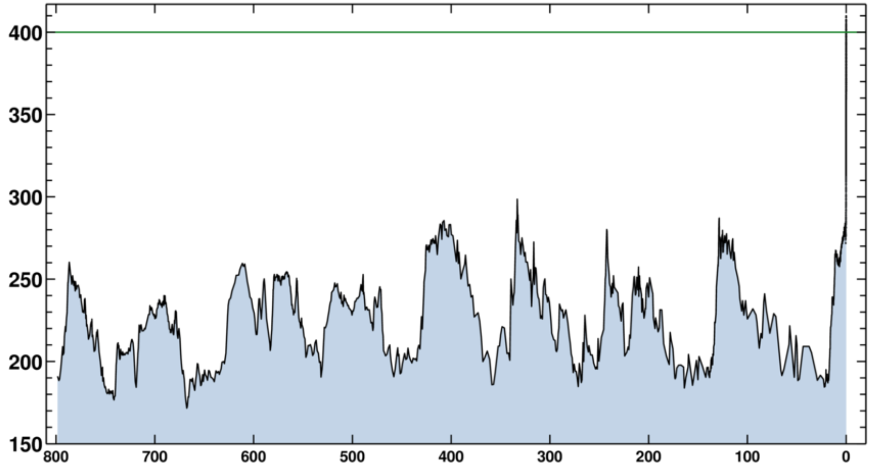
The speed of increase in CO2 is the real problem
It’s significant
400 ppm
300 ppm
CO₂
200 ppm
800,000
years ago
Present
day
Source: Scripps Institution of Oceanography, USA

Slide 24
Possible impacts in Palestine

Slide 25
The health concerns of heat waves in Palestine
Impacts
Increase in mortality among infants and elderly people.
Agriculture – hence food security – is impacted by heat waves: malnutrition and undernutrition.
We urgently need research into extreme events and health impacts in Palestine.
Notes:
Crops respond poorly to extended extreme heat.
Extreme precipitation events lead to runoff instead of percolation – bad for agriculture.

Slide 26
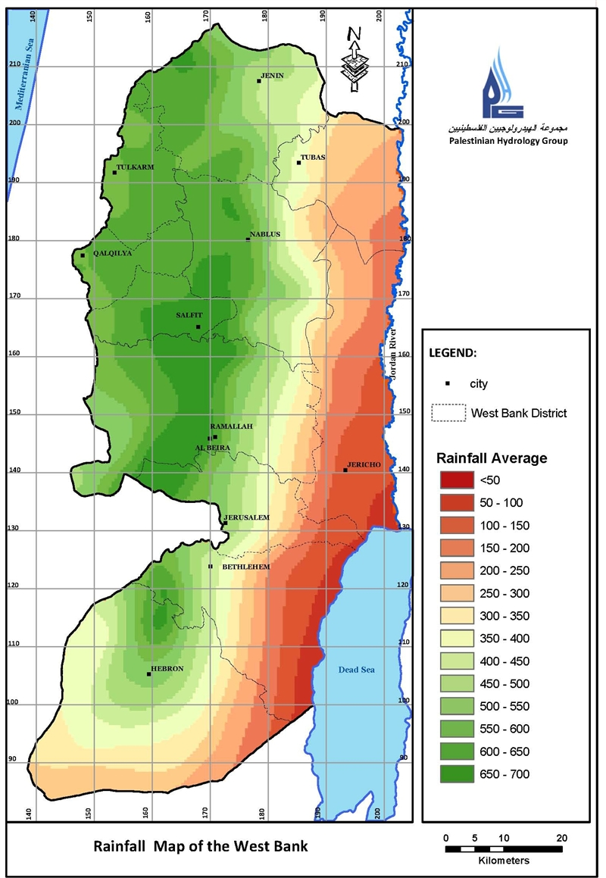
Increasing droughts in dry parts of the World
Impacts
General principle: “Dry becomes drier”.
Large parts of the West Bank are Arid.
Longer and more variable droughts may occur.
Source: Palestine Hydrology Group

Slide 27
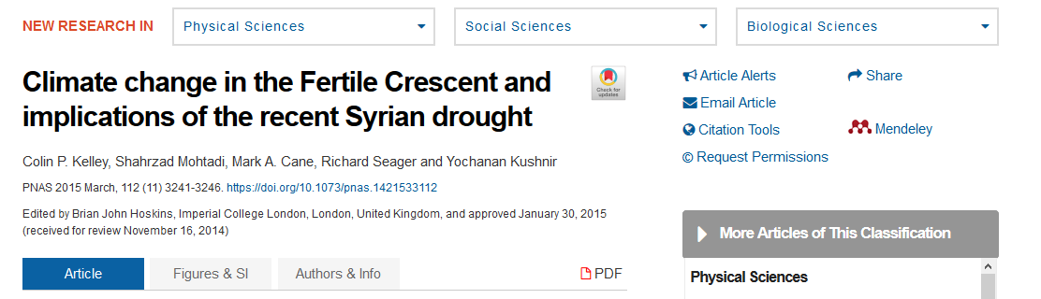
Conflicts over water
Impacts
Kelly et al, PNAS 112 (2015)

Slide 28
The problem:
Increasing CO2 concentrations due to emissions

Slide 29
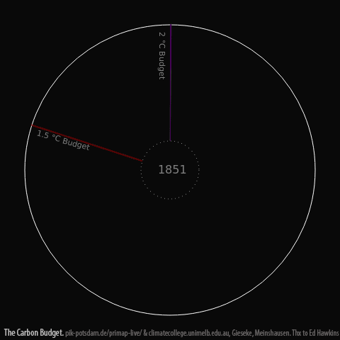
CO2 levels are already dangerously high
Emissions

Slide 30
Who is responsible for this increase?
Who should pay to “clean up”?

Slide 31
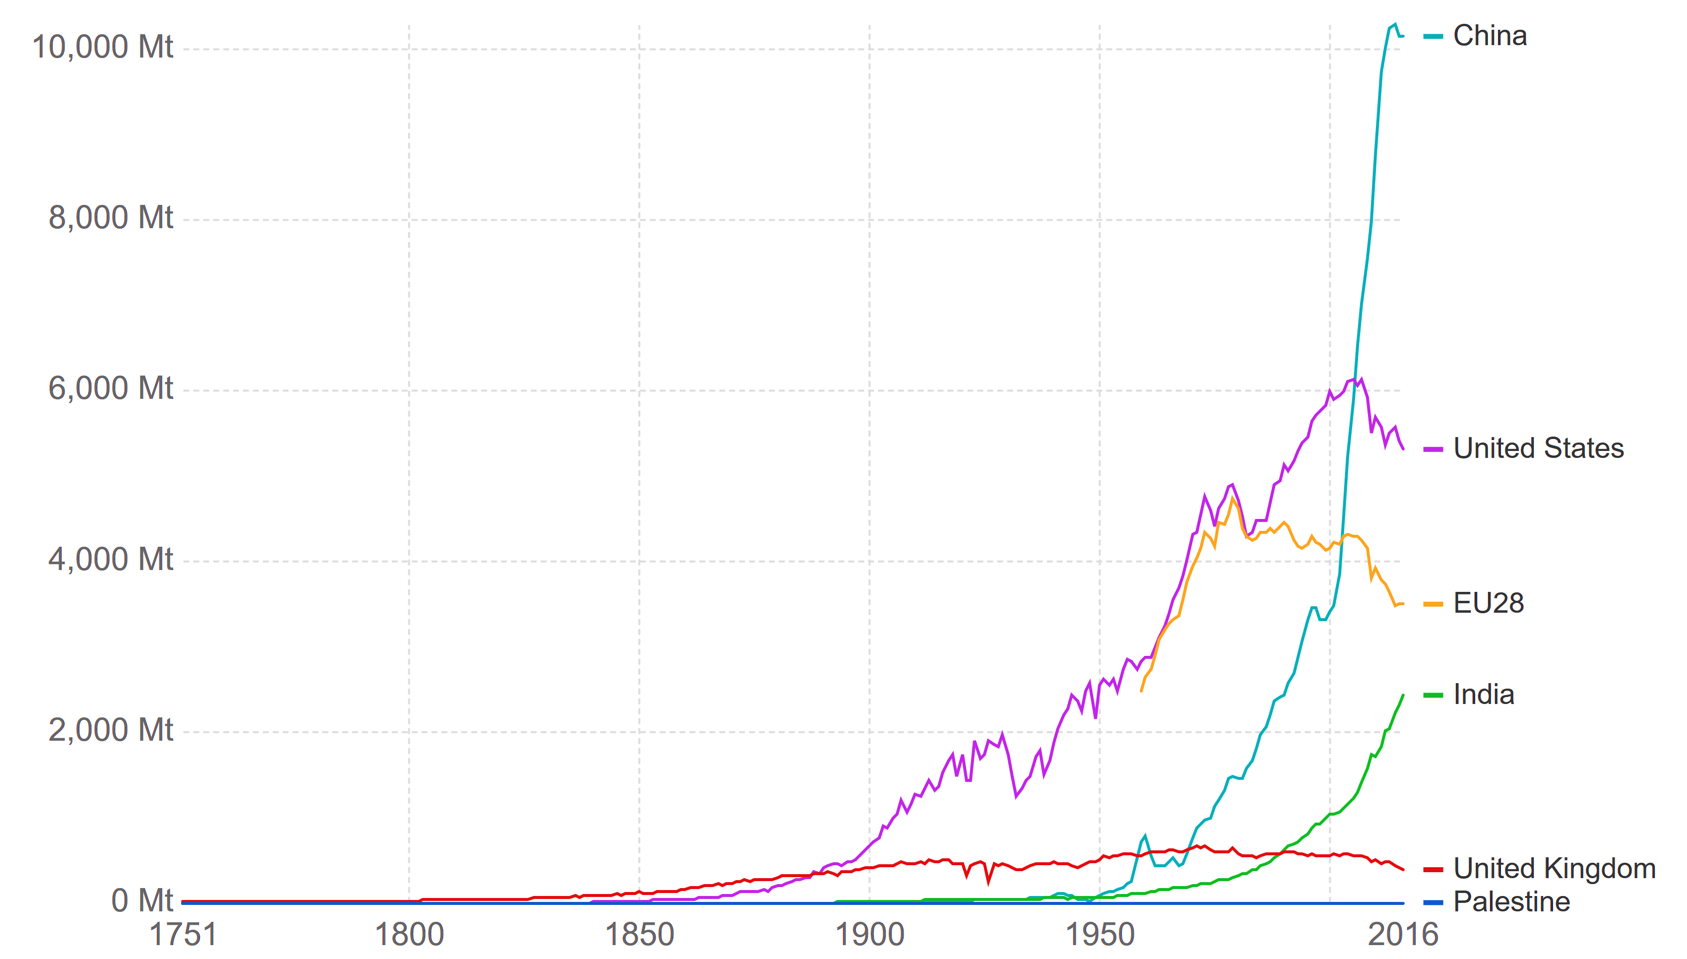
Yearly CO2 emissions by selected countries.
Emissions
Annual CO2 emission
(Millions of tonnes)
Data: Carbon Dioxide Information Analysis Center (CDIAC), Graphic: ourworldindata.org

Slide 32
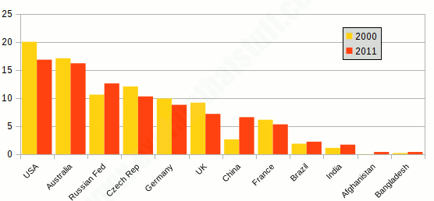
Which countries have the largest CO2 emissions per person?
Emissions
CO2 / person
(tonnes)
Source: UN Statistics Division, Millennium Development Goals Indicators

Slide 33
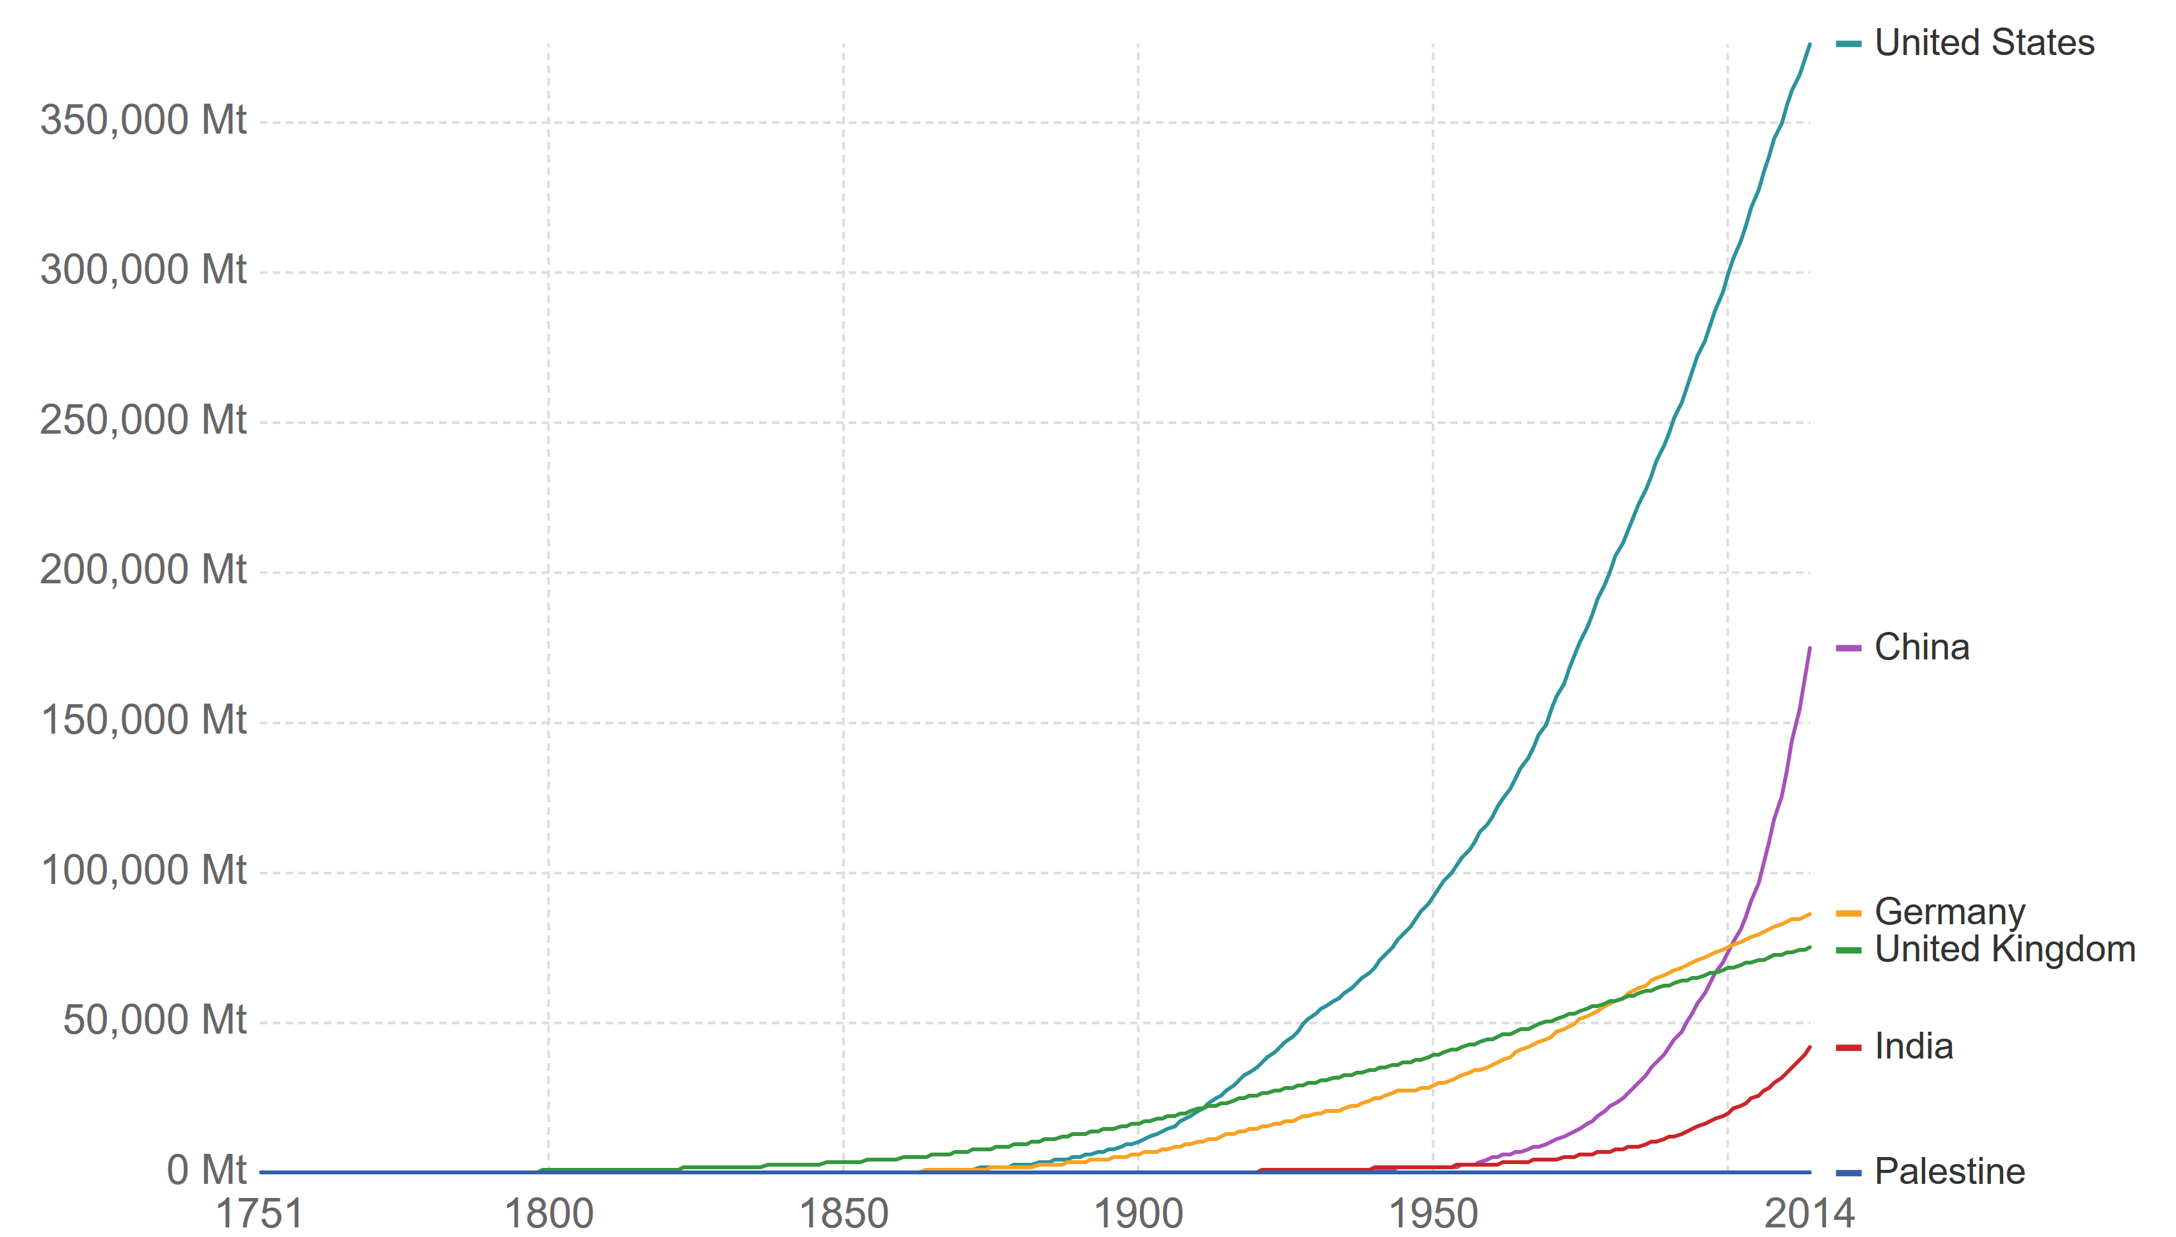
Cumulative CO2 emissions by selected countries since 1750.
Emissions
Annual CO2 emission
(Millions of tonnes)
Data: Carbon Dioxide Information Analysis Center (CDIAC), Graphic: ourworldindata.org

Slide 34
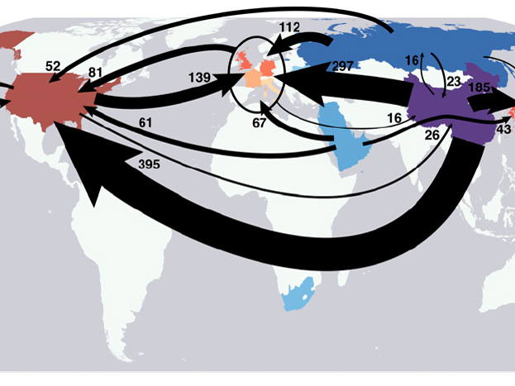
China emits a large amount of CO2 producing goods for the rest of the World
Emissions
Davis, Caldeira PNAS 107 (2010)
Notes:
Largest interregional fluxes of emissions embodied in trade (Mt CO2 y−1) from dominant net exporting countries (blue) to the dominant net importing countries (red). Fluxes to and from Western Europe are aggregated to include the United Kingdom, France, Germany, Switzerland, Italy, Spain, Luxembourg, The Netherlands, and Sweden.

Slide 35
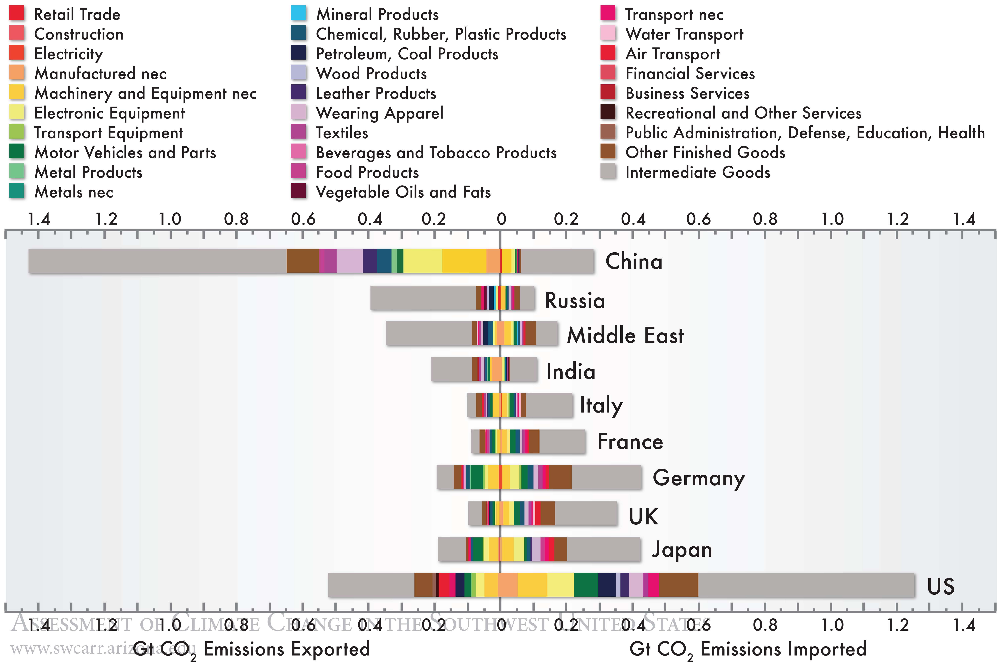
China emits a large amount of CO2, producing goods for the rest of the World
Emissions
Davis, Caldeira PNAS 107 (2010)
Notes:
Balance of CO2 emissions embodied in imports and exports of the largest net importing/exporting countries (and Middle East region). Colors represent
trade in finished goods by industry sector. Traded intermediate goods (gray) are those used by industries in the importing country to meet consumer
demand for domestic goods. nec, “not elsewhere classified.”

Slide 36
Infinite economic growth?

Slide 37
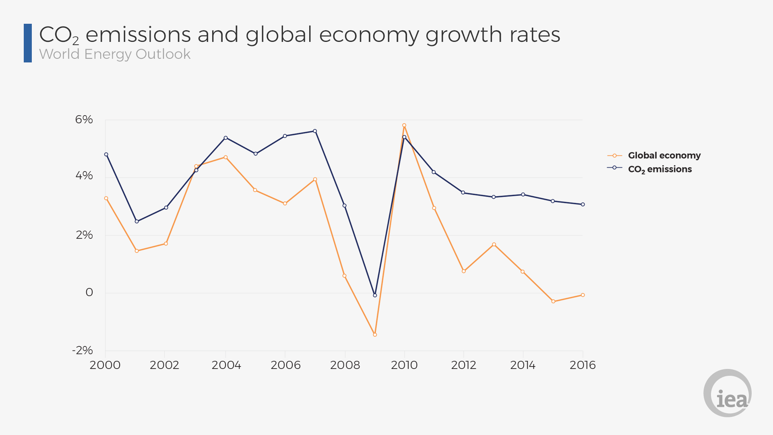
GDP and CO2 emissions
Emissions
Notes:
Balance of CO2 emissions embodied in imports and exports of the largest net importing/exporting countries (and Middle East region). Colors represent
trade in finished goods by industry sector. Traded intermediate goods (gray) are those used by industries in the importing country to meet consumer
demand for domestic goods. nec, “not elsewhere classified.”

Slide 38
What is economic development?
Emissions
“The World GDP has returned to growth after the financial crisis.”
“India’s GDP rose 5.6%.”
Growth in this way is an exponential function.
The assumption is that our economies must keep growing for development.
Notes:
Balance of CO2 emissions embodied in imports and exports of the largest net importing/exporting countries (and Middle East region). Colors represent
trade in finished goods by industry sector. Traded intermediate goods (gray) are those used by industries in the importing country to meet consumer
demand for domestic goods. nec, “not elsewhere classified.”

Slide 39
What is economic development?
Emissions
Growth → Increasing consumption → uses physical resources.
In this perspective: economic growth has necessarily caused environmental damage: pollution and climate change.
The concept of infinite and increasingly faster economic growth based on natural resources on a planet with finite resources is flawed.
Notes:
Balance of CO2 emissions embodied in imports and exports of the largest net importing/exporting countries (and Middle East region). Colors represent
trade in finished goods by industry sector. Traded intermediate goods (gray) are those used by industries in the importing country to meet consumer
demand for domestic goods. nec, “not elsewhere classified.”

Slide 40
What are the alternatives?
Emissions
Increases in efficiency?
Steady state economy?
Using other indicators than economic growth for human development: any merit to “Gross Happiness Index” used in Bhutan?
We may have to voluntarily reduce our consumption.
Notes:
Balance of CO2 emissions embodied in imports and exports of the largest net importing/exporting countries (and Middle East region). Colors represent
trade in finished goods by industry sector. Traded intermediate goods (gray) are those used by industries in the importing country to meet consumer
demand for domestic goods. nec, “not elsewhere classified.”

Slide 41
Why are we so bad at thinking about climate change?

Slide 42
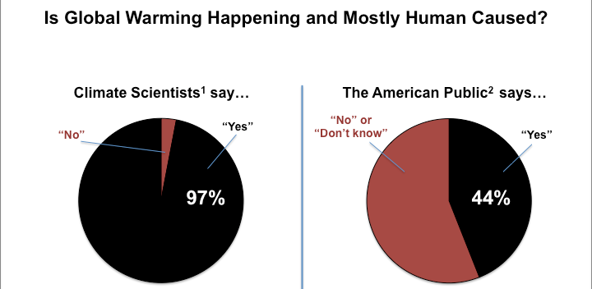
Scientist and public opinions differ
Emissions
When the Science is Not Enough: Communicating the Consensus on Climate Change, PLOS, Sam Illingworth (2015)
Notes:
Balance of CO2 emissions embodied in imports and exports of the largest net importing/exporting countries (and Middle East region). Colors represent
trade in finished goods by industry sector. Traded intermediate goods (gray) are those used by industries in the importing country to meet consumer
demand for domestic goods. nec, “not elsewhere classified.”

Slide 43
The psychology of climate change (lack of) action
Emissions
Climate change is gradual, hard to observe and indefinite in its eventual magnitude.
We have to make sacrifices today to prevent unclear costs in the future.
There is no clear enemy.
Notes:
Balance of CO2 emissions embodied in imports and exports of the largest net importing/exporting countries (and Middle East region). Colors represent
trade in finished goods by industry sector. Traded intermediate goods (gray) are those used by industries in the importing country to meet consumer
demand for domestic goods. nec, “not elsewhere classified.”

Slide 44
The psychology of climate change (lack of) action
Emissions
We are to blame, and everyone we know: it’s in our self interest to discredit it or even deny it.
Green movements communicate individual responsibility, which can lead to resentment.
Notes:
Balance of CO2 emissions embodied in imports and exports of the largest net importing/exporting countries (and Middle East region). Colors represent
trade in finished goods by industry sector. Traded intermediate goods (gray) are those used by industries in the importing country to meet consumer
demand for domestic goods. nec, “not elsewhere classified.”

Slide 45
So how do we change that?
Emissions
It is the health, economics and humans rights concerns of climate change that are more likely to motivation action.
Switch to renewable energy and sustainable living: worthy objectives irrespective of climate change.
Notes:
Balance of CO2 emissions embodied in imports and exports of the largest net importing/exporting countries (and Middle East region). Colors represent
trade in finished goods by industry sector. Traded intermediate goods (gray) are those used by industries in the importing country to meet consumer
demand for domestic goods. nec, “not elsewhere classified.”

Slide 46
Thank you

Slide 47
Supplementary slides

Slide 48
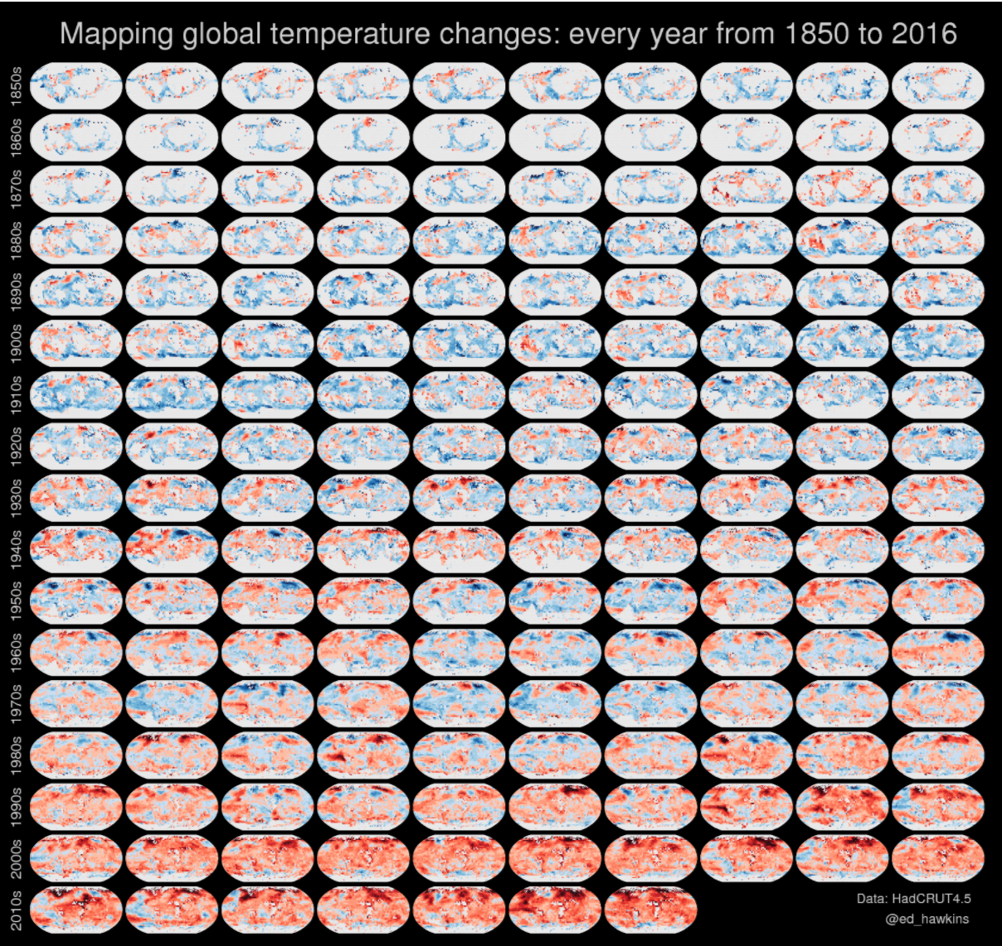
Global temperatures from 1850 to 2016
Observations of changing climate
Data: HadCRUT4.5, Visualization: Ed Hawkins

Slide 49
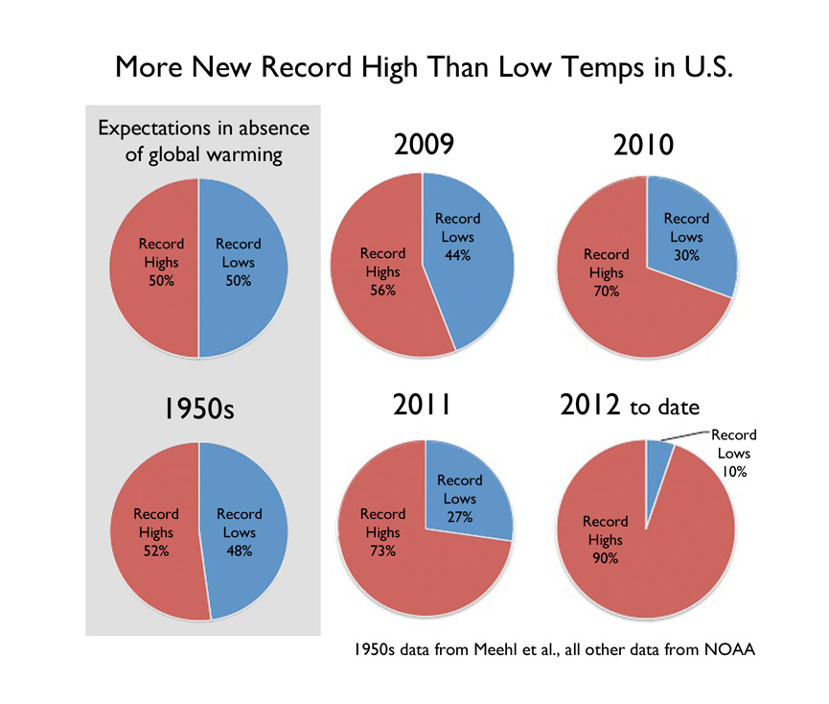
Heat wave intensity is increasing
Impacts
Data: Meehl et al, NOAA

Slide 50
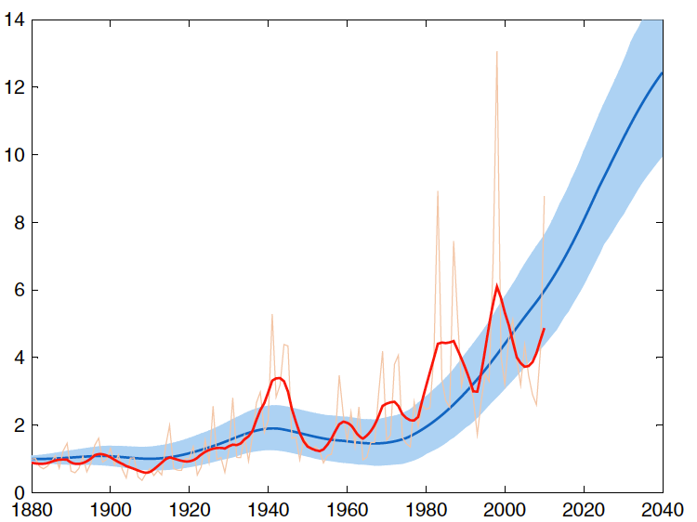
Climate change is rapidly increasing the number of extreme events
Impacts
Ratio of extremes
Year
Data: Meehl et al, NOAA

Slide 51
How is past climate determined?

Slide 52


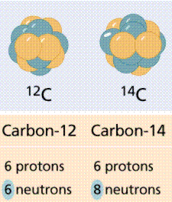
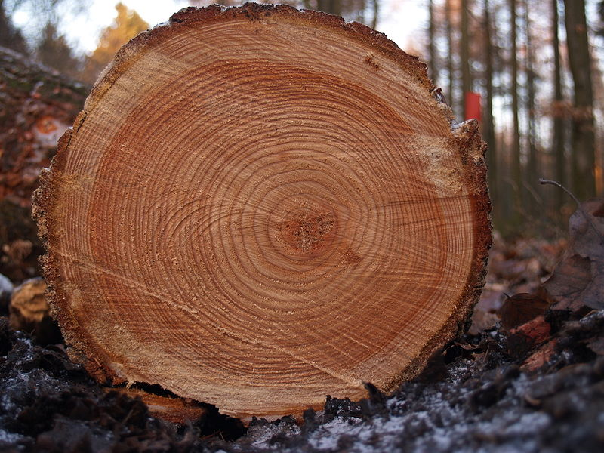
Climate proxies
Paleoclimate
Foraminifera
Radiocarbon dating
Tree rings
Ice cores

Slide 53
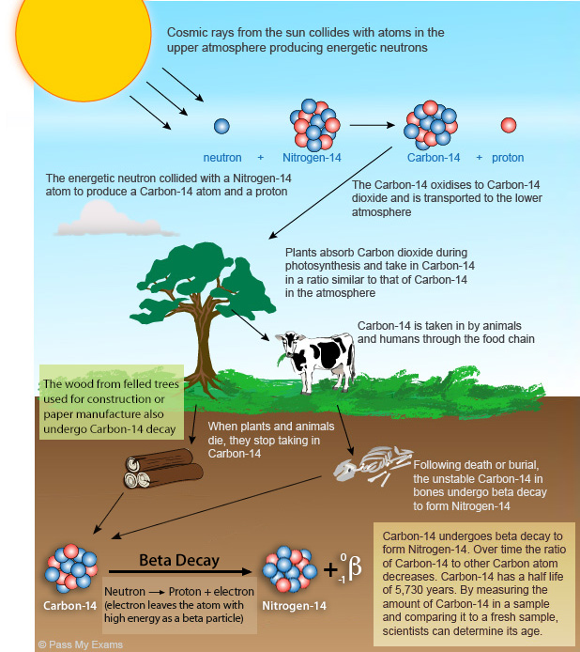
¹⁴C is formed in the atmosphere and accumulates in organic tissues
Paleoclimate // radiocarbon dating

Slide 54
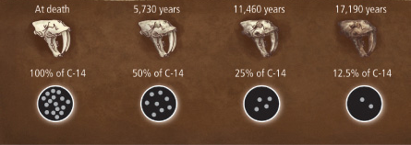
¹⁴C decays in dead tissue
Paleoclimate // radiocarbon dating

Slide 55
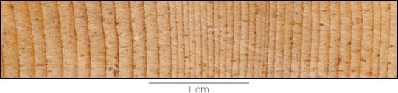
Tree rings: the number
Paleoclimate // tree rings
Number of rings tells us the age of the tree
NASA Earth Observatory
Notes:
https://earthobservatory.nasa.gov/Features/Paleoclimatology_CloseUp/

Slide 56
Tree rings: their width
Paleoclimate // tree rings
Width of tree rings record annual rainfall
Higher rainfall
Drought
NASA Earth Observatory
Notes:
https://earthobservatory.nasa.gov/Features/Paleoclimatology_CloseUp/

Slide 57
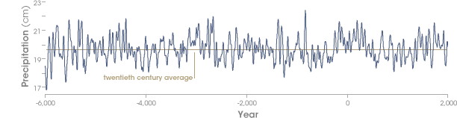
Annual rainfall for 1000s of years in Sierra Nevada, Spain
Paleoclimate // tree rings
High rainfall
Drought
Hughes 1996
Notes:
Short- and long-term variability of rainfall along the eastern margin of the Sierra Nevada is recorded in bristlecone tree rings. Several long and intense droughts that appear in the tree-rings are also found in sediments in nearby Mono Lake. (Graph derived from Hughes 1996): https://earthobservatory.nasa.gov/Features/Paleoclimatology_CloseUp/

Slide 58
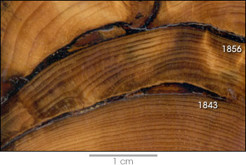
Events like forest fires can also be written in trees
Paleoclimate // tree rings
Fire scars
NASA Earth Observatory
Notes:
Individual events such as forest fires are recorded in tree-rings. The dark arcs that interrupt the sequence of rings in this sample were caused by fires in the 19th century.
: https://earthobservatory.nasa.gov/Features/Paleoclimatology_CloseUp/

Slide 59
Ice cores as a climate proxy
Paleoclimate // ice cores
Ice builds up incrementally. Deeper ice is older.
¹⁸O/¹⁶O isotopic ratio is an indicator of temperature.
Composition of trapped air bubbles gives atmospheric composition.
Google Earth Image
Notes:
Heavier isotopes have a higher boiling point.

Slide 60
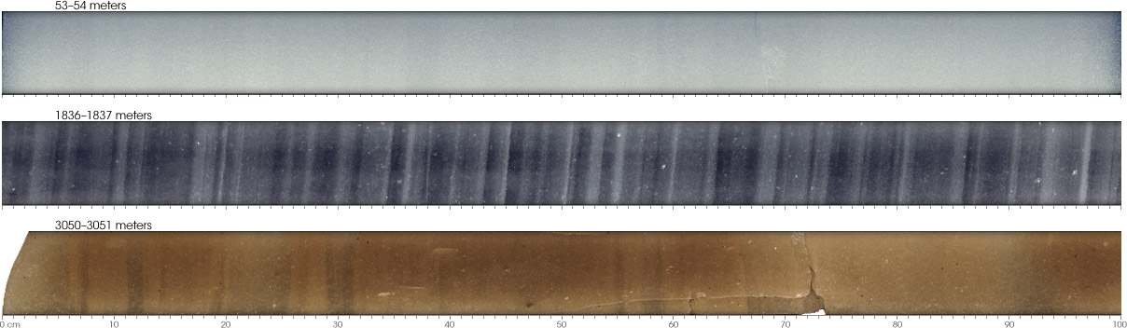
What do ice cores look like?
Paleoclimate // ice cores
Ice column
Cross sections
Old ice
close to bottom
Fresh ice
Source: NASA Earth Observatory
Notes:
https://earthobservatory.nasa.gov/Features/Paleoclimatology_IceCores/
The gradually increasing weight of overlying layers compresses deeply buried snow into ice, but annual bands remain. Relatively young and shallow snow becomes packed into coarse and granular crystals called firn (top: 53 meters deep). Older and deeper snow is compacted further (middle: 1,836 meters). At the bottom of a core (lower: 3,050 meters), rocks, sand, and silt discolor the ice. (Photographs courtesy U.S. National Ice Core Laboratory)
The ice cores can provide an annual record of temperature, precipitation, atmospheric composition, volcanic activity, and wind patterns. In a general sense, the thickness of each annual layer tells how much snow accumulated at that location during the year. Differences in cores taken from the same area can reveal local wind patterns by showing where the snow drifted. More importantly, the make-up of the snow itself can tell scientists about past temperatures. As with marine fossils, the ratio of oxygen isotopes in the snow reveals temperature, though in this case, the ratio tells how cold the air was at the time the snow fell. In snow, colder temperatures result in higher concentrations of light oxygen. (See The Oxygen Balance.)
Researchers retrieve climate records from mountain glaciers in addition to the records from polar ice sheets. Drilling sites around the world help distinguish trends in local climate from trends in global climate. This drilling station is located at an elevation of 6,425 meters (21,080 feet) on the summit of Nevado Coropuna in the Peruvian Andes. (Photograph copyright Jason Box, Ohio State University/Byrd Polar Research Center)

Slide 61
Age of ice can be computed by counting seasonal layers
Paleoclimate // ice cores
Old ice
close to bottom
Fresh ice
Source: NASA Earth Observatory
Notes:
https://earthobservatory.nasa.gov/Features/Paleoclimatology_IceCores/
The gradually increasing weight of overlying layers compresses deeply buried snow into ice, but annual bands remain. Relatively young and shallow snow becomes packed into coarse and granular crystals called firn (top: 53 meters deep). Older and deeper snow is compacted further (middle: 1,836 meters). At the bottom of a core (lower: 3,050 meters), rocks, sand, and silt discolor the ice. (Photographs courtesy U.S. National Ice Core Laboratory)
The ice cores can provide an annual record of temperature, precipitation, atmospheric composition, volcanic activity, and wind patterns. In a general sense, the thickness of each annual layer tells how much snow accumulated at that location during the year. Differences in cores taken from the same area can reveal local wind patterns by showing where the snow drifted. More importantly, the make-up of the snow itself can tell scientists about past temperatures. As with marine fossils, the ratio of oxygen isotopes in the snow reveals temperature, though in this case, the ratio tells how cold the air was at the time the snow fell. In snow, colder temperatures result in higher concentrations of light oxygen. (See The Oxygen Balance.)
Researchers retrieve climate records from mountain glaciers in addition to the records from polar ice sheets. Drilling sites around the world help distinguish trends in local climate from trends in global climate. This drilling station is located at an elevation of 6,425 meters (21,080 feet) on the summit of Nevado Coropuna in the Peruvian Andes. (Photograph copyright Jason Box, Ohio State University/Byrd Polar Research Center)

Slide 62
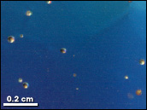
Age of ice can be computed by counting seasonal layers
Paleoclimate // ice cores
Source: NASA Earth Observatory
Notes:
Air bubbles trapped in the ice cores provide a record of past atmospheric composition. Ice core records prove that current levels of carbon dioxide and methane, both important greenhouse gases, are higher than any previous level in the past 400,000 years. (Photograph courtesy U.S. National Ice Core Laboratory)

Slide 63
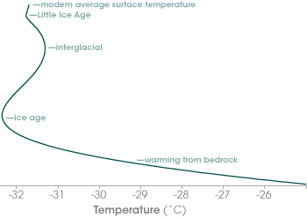
Ice also preserves temperatures
Paleoclimate // ice cores
Surface
0
500
Depth (m)
1000
1500
2000
Deep
Colder
Warmer
Notes:
https://earthobservatory.nasa.gov/Features/Paleoclimatology_IceCores/

Slide 64
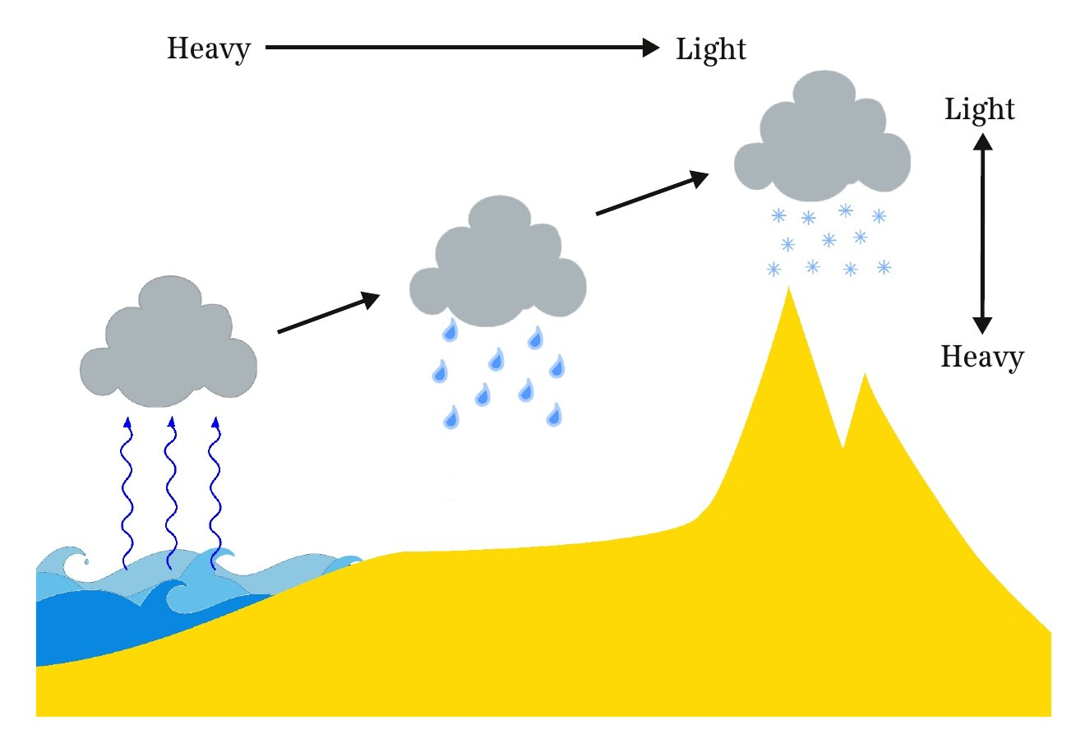
Temperature controls the isotopic ratio
Paleoclimate // ice cores
Distillation
Principles of Planetary climate, R. Pierrehumbert

Slide 65
Climate record written into deep ocean
Paleoclimate // forams
Year after year, fossils of plants and fish settle on ocean floor.
Vertical samples of ocean sediment yield millions of years of climate history!
Among these, fossils of forams, have proven most useful.

Slide 66
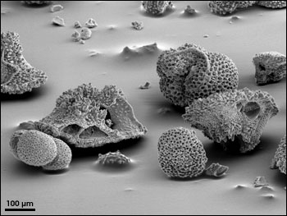
Forams
Paleoclimate // forams
Forams are marine organisms that form CaCO₃ shells.
¹⁸O / ¹⁶O isotopic ratio can reveal the temperature of the ocean.
Shells are enriched in heavy Oxygen in colder waters.

Slide 67
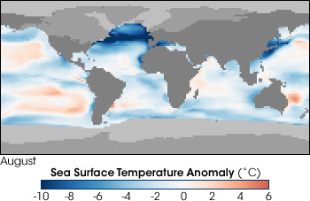
Sea Surface Temperature at peak of last ice age:
20,000 years ago
Paleoclimate // forams
From ocean and lake sediment cores
https://earthobservatory.nasa.gov/Features/Paleoclimatology_SedimentCores/paleoclimatology_sediment_cores_2.php
Notes:
he CLIMAP (Climate: Long-Range Investigation, Mapping, and Prediction) project developed maps of sea surface temperatures during the peak of the last Ice Age based on ocean and lake sediment cores. This map shows the difference in temperatures between then and now (blue areas were colder, red areas warmer). One interesting feature is the presence of much colder water in the North Atlantic—evidence that the Gulf Stream Current has shifted in the past.

Slide 68
Variations in the past 800,000 years
Paleoclimate reconstruction
Notes:
Page 400 of IPCC’s WG1AR5_Chapter05_FINAL.pdf: Orbital parameters and proxy records over the past 800 kyr. (a) Eccentricity. (b) Obliquity. (c) Precessional parameter (Berger and Loutre, 1991). (d) Atmospheric concentration of CO2 from Antarctic ice cores (Petit et al., 1999; Siegenthaler et al., 2005; Ahn and Brook, 2008; Lüthi et al., 2008). (e) Tropical sea surface temperature stack (Herbert et al., 2010). (f) Antarctic temperature stack based on up to seven different ice cores (Petit et al., 1999; Blunier and Brook, 2001; Watanabe et al., 2003; European Project for Ice Coring in Antarctica (EPICA) Community Members, 2006; Jouzel et al., 2007; Stenni et al., 2011). (g) Stack of benthic d18O, a proxy for global ice volume and deep-ocean temperature (Lisiecki and Raymo, 2005). (h) Reconstructed sea level (dashed line: Rohling et al., 2010; solid line: Elder eld et al., 2012). Lines represent orbital forcing and proxy records, shaded areas represent the range of simulations with climate models (Grid Enabled Integrated Earth System Model-1, GENIE-1, Holden et al., 2010a; Bern3D, Ritz et al., 2011), climate–ice sheet models of intermediate complexity (CLIMate and BiosphERe model, CLIMBER-2, Ganopolski and Calov, 2011) and an ice sheet model (ICe sheet model for Integrated Earth system studies, IcIES, Abe-Ouchi et al., 2007) forced by variations of the orbital parameters and the atmospheric concentrations of the major greenhouse gases. (i) Rate of changes of global mean temperature during Termination I based on Shakun et al. (2012).

Slide 69
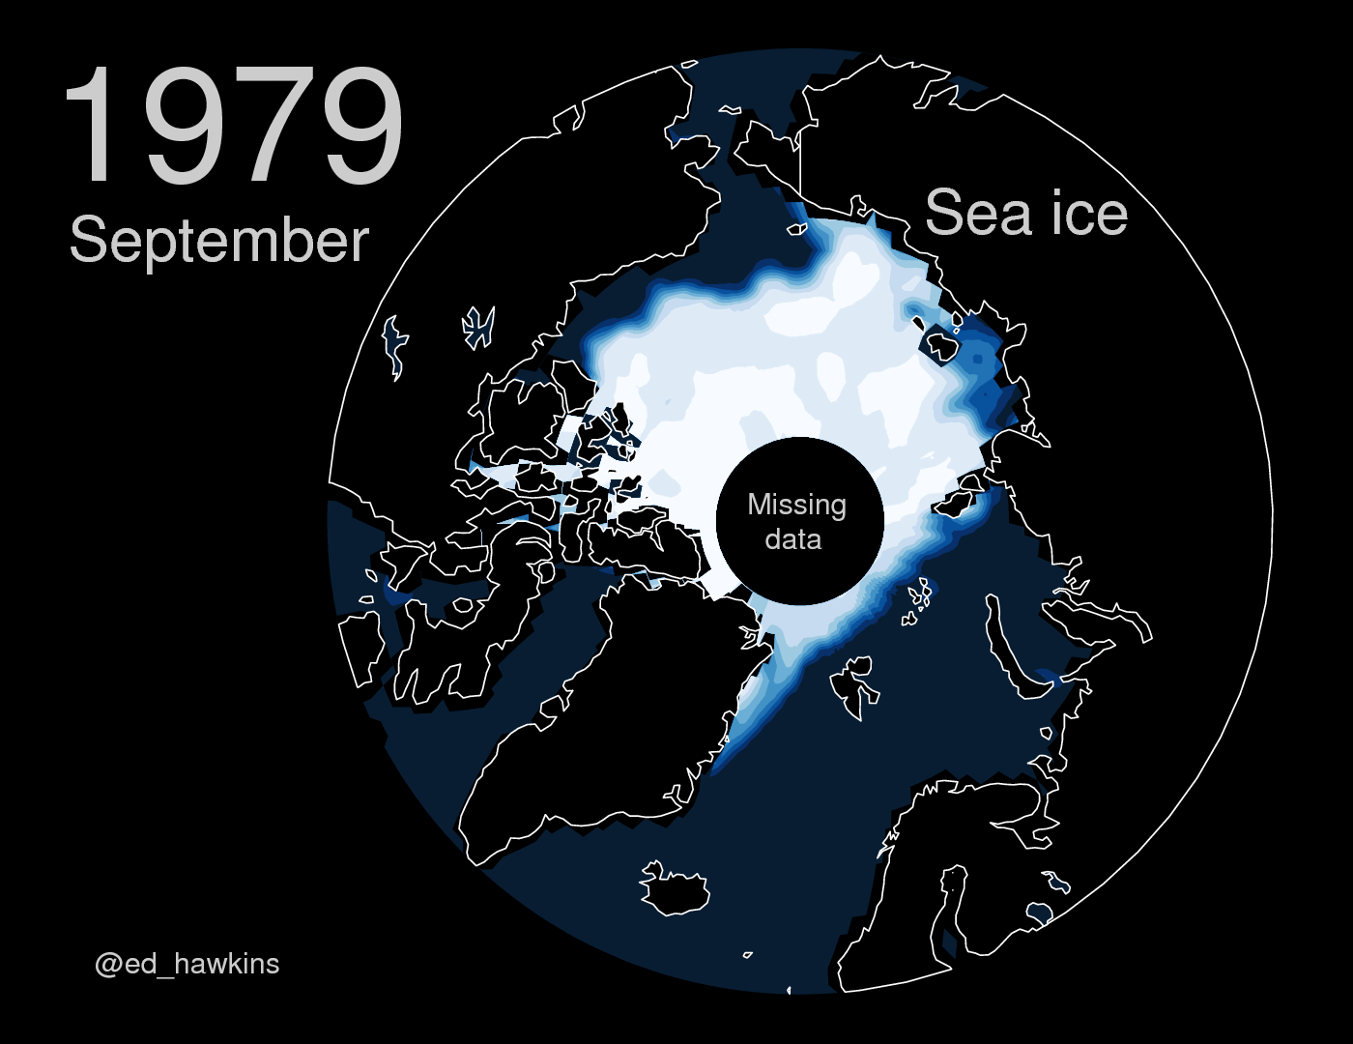
Arctic summer sea ice extent
Observation of climate change
Source: http://blogs.reading.ac.uk/climate-lab-book/files/2017/05/maparctic_sept.gif

Slide 70
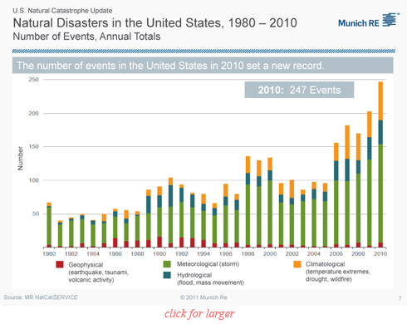
Extreme events are increasing in the US.
Observations of changing climate

Slide 71
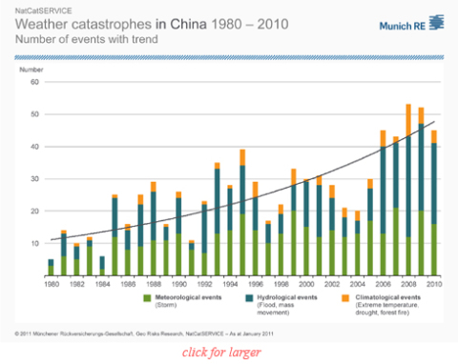
Extreme events are increasing in China.
Observations of changing climate

Slide 72
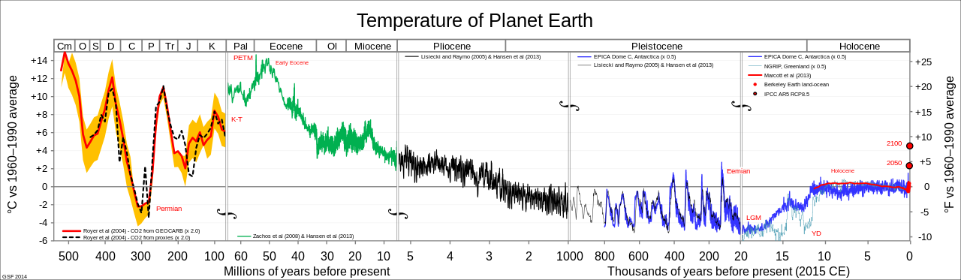
Reconstructed records for the past 500 million years.
Paleoclimate // forams
https://earthobservatory.nasa.gov/Features/Paleoclimatology_SedimentCores/paleoclimatology_sediment_cores_2.php
Notes:
he CLIMAP (Climate: Long-Range Investigation, Mapping, and Prediction) project developed maps of sea surface temperatures during the peak of the last Ice Age based on ocean and lake sediment cores. This map shows the difference in temperatures between then and now (blue areas were colder, red areas warmer). One interesting feature is the presence of much colder water in the North Atlantic—evidence that the Gulf Stream Current has shifted in the past.

Slide 73
Global temperatures from 1880 to 2016 relative to average for 1901 – 2000.
Observations of changing climate
Data and visualization: NOAA.

Slide 74
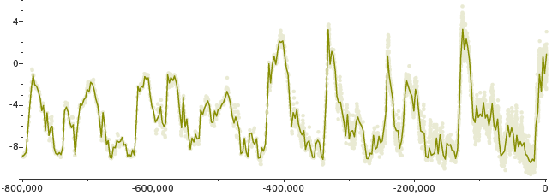
Past changes in global temperature
Observations of changing climate
Change in
Temperature
(ºC)
Year
IPCC 2007
Notes:
Till 2005.

Slide 75
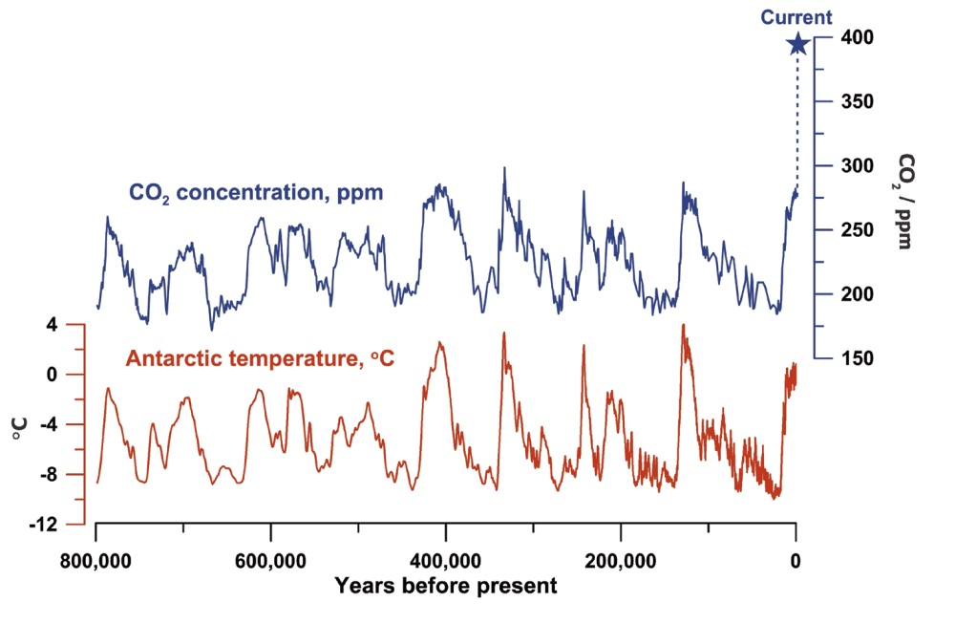
CO₂ and temperature co-vary. Current CO₂ levels are highest in almost a million years.
Observations of changing climate
CO₂ (ppm)
T (ºC)
Source: Figure by Jeremy Shakun, data from Lüthi et al., 2008 and Jouzel et al., 2007.

Slide 76
Variations in the past 800,000 years
Paleoclimate reconstruction
Notes:
Page 400 of IPCC’s WG1AR5_Chapter05_FINAL.pdf: Orbital parameters and proxy records over the past 800 kyr. (a) Eccentricity. (b) Obliquity. (c) Precessional parameter (Berger and Loutre, 1991). (d) Atmospheric concentration of CO2 from Antarctic ice cores (Petit et al., 1999; Siegenthaler et al., 2005; Ahn and Brook, 2008; Lüthi et al., 2008). (e) Tropical sea surface temperature stack (Herbert et al., 2010). (f) Antarctic temperature stack based on up to seven different ice cores (Petit et al., 1999; Blunier and Brook, 2001; Watanabe et al., 2003; European Project for Ice Coring in Antarctica (EPICA) Community Members, 2006; Jouzel et al., 2007; Stenni et al., 2011). (g) Stack of benthic d18O, a proxy for global ice volume and deep-ocean temperature (Lisiecki and Raymo, 2005). (h) Reconstructed sea level (dashed line: Rohling et al., 2010; solid line: Elder eld et al., 2012). Lines represent orbital forcing and proxy records, shaded areas represent the range of simulations with climate models (Grid Enabled Integrated Earth System Model-1, GENIE-1, Holden et al., 2010a; Bern3D, Ritz et al., 2011), climate–ice sheet models of intermediate complexity (CLIMate and BiosphERe model, CLIMBER-2, Ganopolski and Calov, 2011) and an ice sheet model (ICe sheet model for Integrated Earth system studies, IcIES, Abe-Ouchi et al., 2007) forced by variations of the orbital parameters and the atmospheric concentrations of the major greenhouse gases. (i) Rate of changes of global mean temperature during Termination I based on Shakun et al. (2012).

Slide 77
China emits a large amount of CO2 producing goods for the rest of the World
Emissions
Davis, Caldeira PNAS 107 (2010)
Notes:
Balance of CO2 emissions embodied in imports and exports of the largest net importing/exporting countries (and Middle East region). Colors represent
trade in finished goods by industry sector. Traded intermediate goods (gray) are those used by industries in the importing country to meet consumer
demand for domestic goods. nec, “not elsewhere classified.”

Slide 78
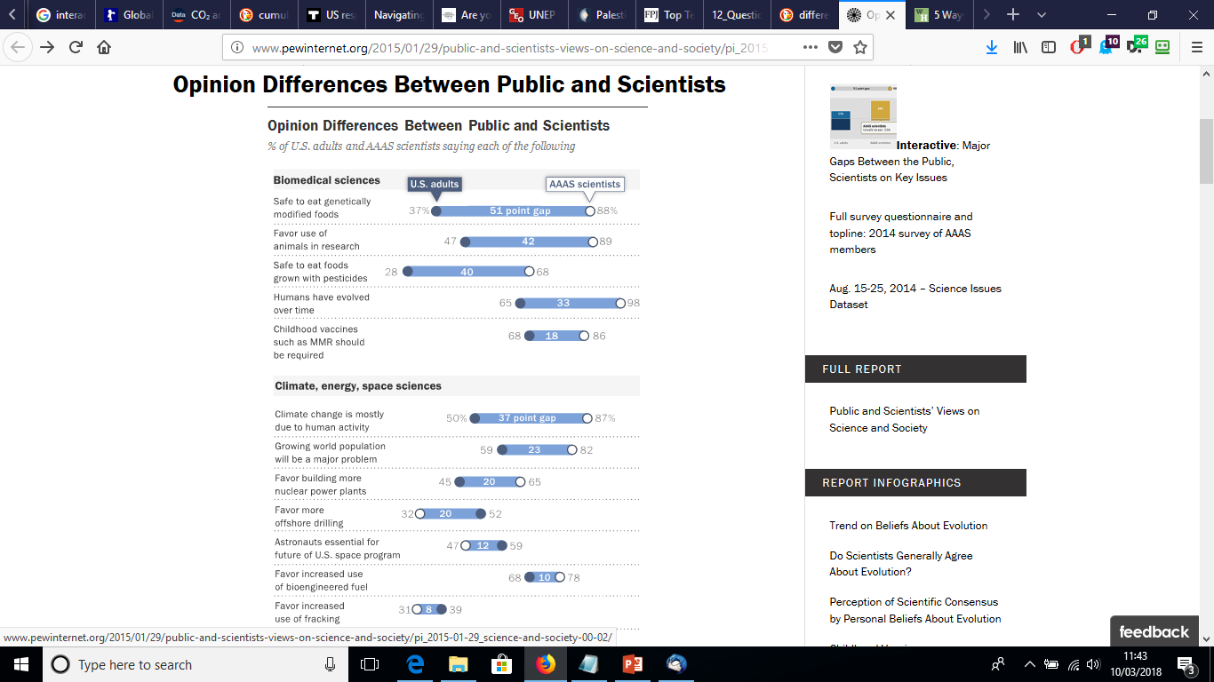
China emits a large amount of CO2 producing goods for the rest of the World
Emissions
Notes:
Balance of CO2 emissions embodied in imports and exports of the largest net importing/exporting countries (and Middle East region). Colors represent
trade in finished goods by industry sector. Traded intermediate goods (gray) are those used by industries in the importing country to meet consumer
demand for domestic goods. nec, “not elsewhere classified.”

Slide 79
China emits a large amount of CO2 producing goods for the rest of the World
Emissions
Notes:
Balance of CO2 emissions embodied in imports and exports of the largest net importing/exporting countries (and Middle East region). Colors represent
trade in finished goods by industry sector. Traded intermediate goods (gray) are those used by industries in the importing country to meet consumer
demand for domestic goods. nec, “not elsewhere classified.”

Slide 80
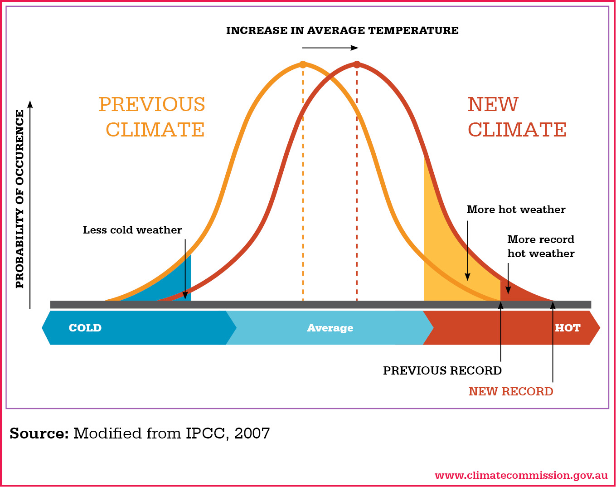
Intuitive explanation for why temperature extremes rise
Climate impacts

